Slide 1
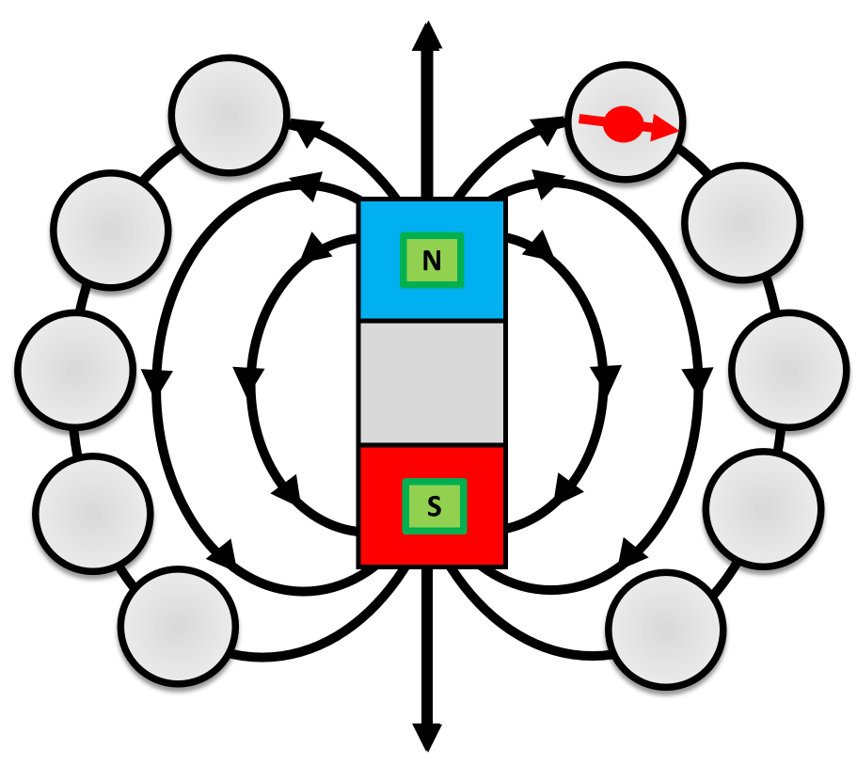
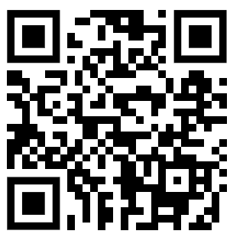
Demonstrating Magnetic Fields Question
The diagram below shows how magnetic fields can be investigated
Mark Scheme
What instrument is used to plot magnetic field lines around a magnet?
What do the arrows on magnetic field lines show?
Where is the magnetic field strongest around a bar magnet?
What shape are the magnetic field lines around a bar magnet?

