Slide 1
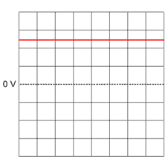
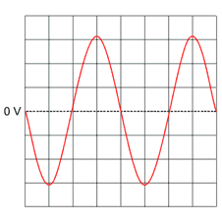

ACDC Question
The diagram below shows the differences between alternating current (AC) and direct current (DC).
What does AC stand for in electricity?
Mark Scheme
What type of current is supplied by batteries?
Which type of current repeatedly changes direction?
What is the frequency of mains electricity in the UK?

