Slide 1
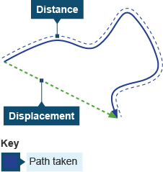

Distance & Displacement Question
Explain the difference between distance and displacement, giving examples.
Key things to include:
What distance is
What displacement is
How you would work them out
_______________________________________________________________________________________________________________________________________________________________________________________________________________________________________________________________________________________________________________________________________________________________________________________________________________________________________
Answer
Link to video

