Slide 1
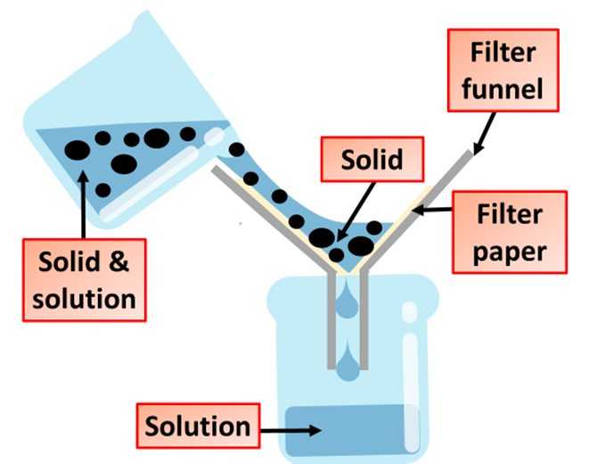

Making Salts Practice Question
A student investigated the reactions of copper carbonate and copper oxide with dilute hydrochloric acid. In both reactions one of the products is copper chloride. Describe how a sample of copper chloride crystals could be made from copper carbonate and dilute hydrochloric acid.
Key things to include:
How much copper carbonate do we use
How is unreacted copper carbonate separated
How can we get rid of the excess water
Answer
________________________________________________________________________________________________________________________________________________________________________________________________________________________________________________________________________________________________________________________________________________________________________________________
Link to video

Slide 2
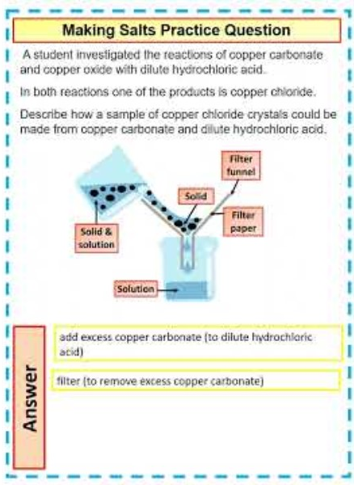
Making Salts Practice Question

