Slide 1

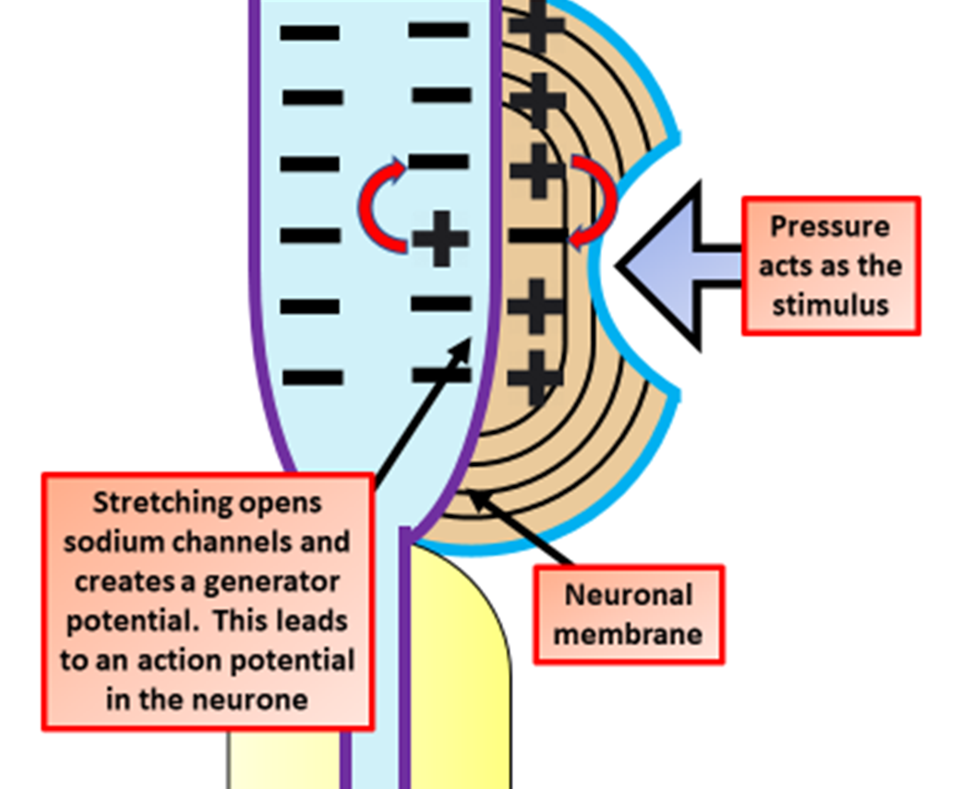

The Great Biology Pubish Quiz
Pacinian Corpuscle

Slide 2

The Great Biology Pubish Quiz
Pacinian Corpuscle
What type of stimulus does a Pacinian corpuscle detect?
A
Heat
Pressure
B
C
Light
D
Sound

Slide 3
The Great Biology Pubish Quiz
Pacinian Corpuscle
What part of the Pacinian corpuscle is deformed to start an impulse?
A
Myelin
Nucleus
B
C
Lamellae
D
Dendrite

Slide 4
The Great Biology Pubish Quiz
Pacinian Corpuscle
Which type of ion channel opens when a Pacinian corpuscle is stimulated?
A
Sodium
Chloride
B
C
Potassium
D
Calcium

Slide 5
The Great Biology Pubish Quiz
Pacinian Corpuscle
What is generated when the membrane becomes depolarised in the Pacinian corpuscle?
A
Synapse
Hormone
B
C
Action
D
Impulse

Slide 6
The Great Biology Pubish Quiz
Pacinian Corpuscle
What type of receptor is a Pacinian corpuscle?
A
Chemoreceptor
Thermoreceptor
B
C
Mechanoreceptor
D
Osmoreceptor

Slide 7
The Great Biology Pubish Quiz
Pacinian Corpuscle
Where in the body are Pacinian corpuscles commonly found?
A
Brain
B
Retina
C
Skin
D
Liver

Slide 8

The Great Biology Pubish Quiz
Pacinian Corpuscle
Question 1
B
Question 2
C
Question 3
A
Question 4
D
Question 5
C
C

