Slide 1
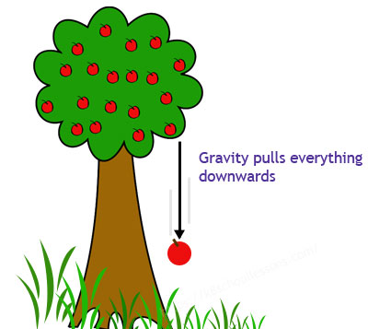
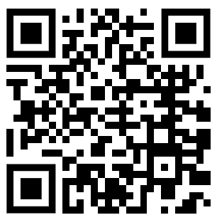
Gravity Question
The diagram shows the effects of gravity
Mark Scheme
What is the force that pulls objects toward the centre of the Earth?
What is the approximate gravitational field strength on Earth?
What happens to the weight of an object if gravity increases?
What two factors affect the gravitational force between two objects?

