Slide 1
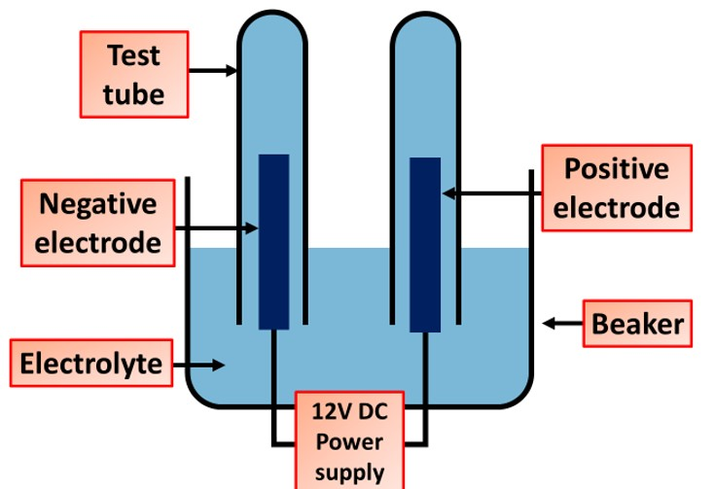

Electrolysis Question
The diagram below shows how an electrolysis practical is set up
Video link
What is electrolysis?
What type of substance can be electrolyzed?
What is the name of the positive electrode in electrolysis?
What is the name of the negative electrode in electrolysis?

