Slide 1


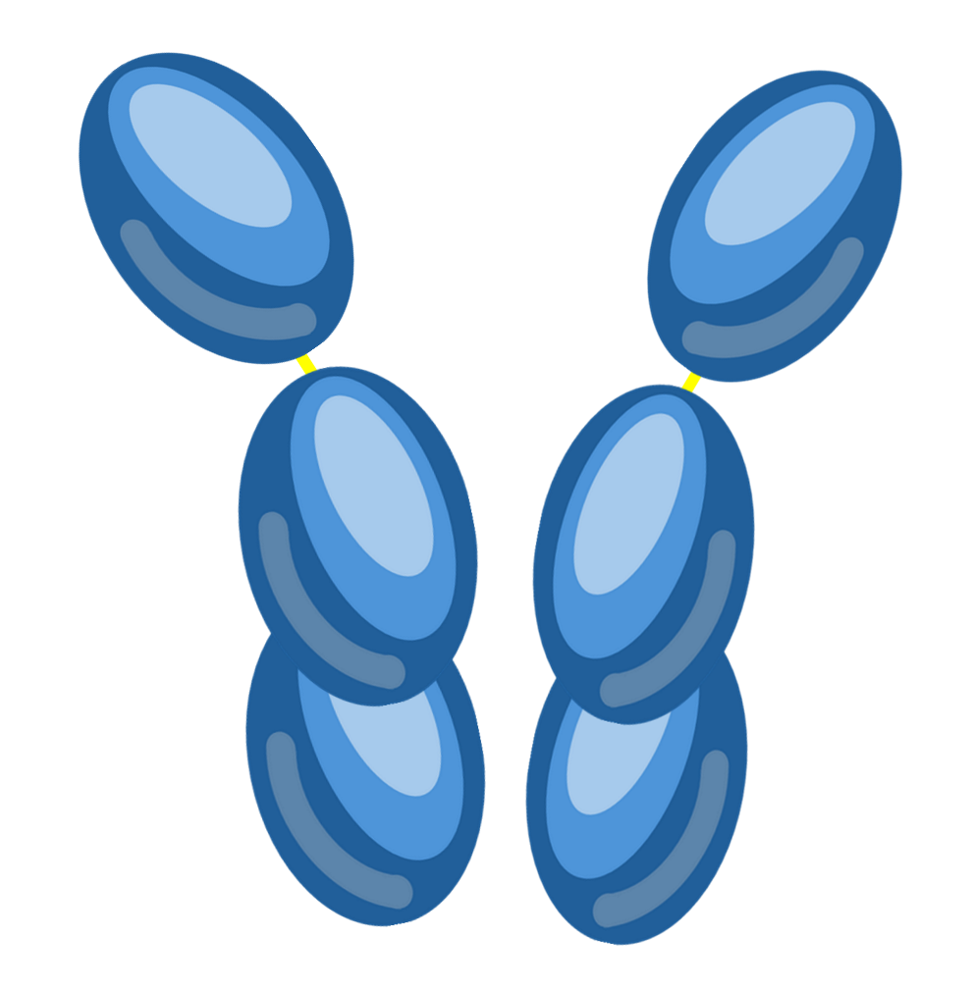

The Structure of Antibodies
Hinge region – A flexible region between the arms of the antibody that allows it to bend, helping the antibody bind to antigens that are spaced differently.
Variable regions – Regions at the ends of the heavy and light chains with a unique amino acid sequence. These regions create a specific shape that binds to a particular antigen.
Heavy chains – Two long polypeptide chains that form the main structure of the antibody. They determine the class of antibody (e.g. IgG, IgA) and are involved in immune functions such as binding to phagocytes.
Disulfide bonds – Strong covalent bonds that hold the heavy chains together and attach the light chains to the heavy chains, maintaining the antibody’s structure.
Light chains – Two shorter polypeptide chains attached to the heavy chains. Together with the heavy chains, they help form the antigen-binding sites.
Antigen-binding sites – The specific areas formed by the variable regions of the heavy and light chains. Each antibody has two antigen-binding sites.
Constant regions – Regions of the heavy and light chains with the same structure in antibodies of the same class. They determine how the antibody interacts with other parts of the immune system.

