Slide 1
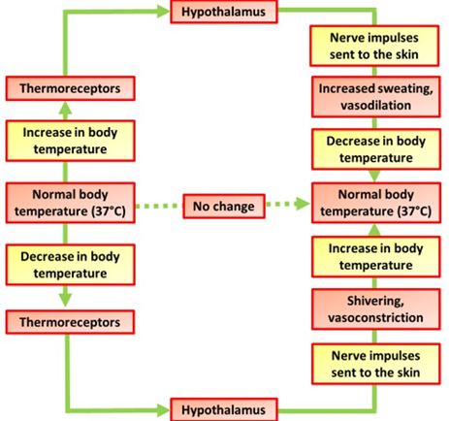

Thermoregulation Question
Explain how the human body responds when the core body temperature falls below the normal range. Include details of the physiological mechanisms involved.
___________________________________________________________________________________________________________________________________________________________________________________________________________________________________________________________________________________________________________________________________________________________________________________________________________________________________________________________________________________________________________________________________________________________________________________________________________________________________
Answer
Link to video

