Slide 1
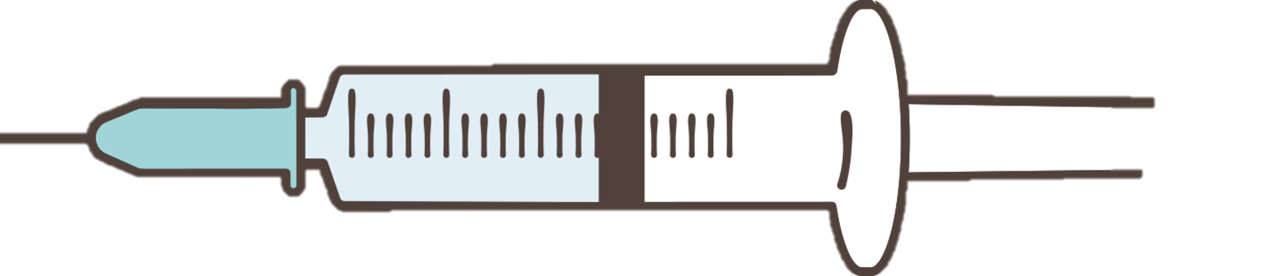

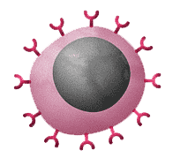
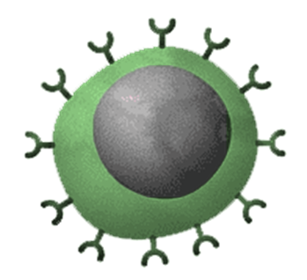
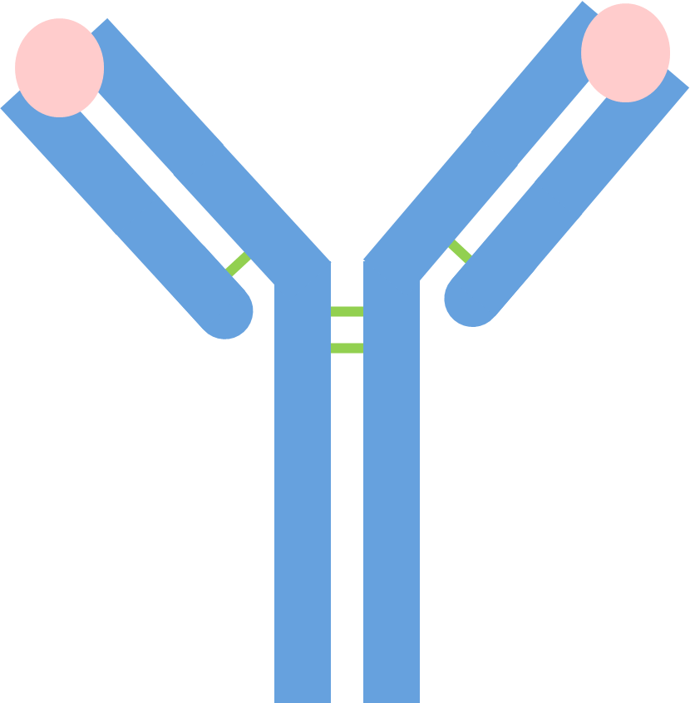
2: Immune System Activation: The immune system recognizes the antigens in the vaccine as foreign.
How Vaccination Works
4: Memory Cell Formation: The immune system creates memory cells that "remember" the specific pathogen's antigens.
B lymphocyte
Antibodies
Memory cells
Vaccine
3: Producing antibodies: White blood cells, especially lymphocytes, respond by producing specific antibodies.
5: Future Protection: If the actual pathogen enters the body later, the memory cells quickly recognize it and produce antibodies, destroying it before it causes illness. This prevents the person from getting sick.
1: Introducing the Vaccine: A vaccine is injected into the body. It contains a harmless part of a pathogen, such as dead, weakened, or inactivated microbes, or just their antigens.

Slide 2
How Vaccination Works
2: Immune System Activation:
4: Memory Cell Formation:.
B lymphocyte
Antibodies
Memory cells
Vaccine
5: Future Protection:
1: Introducing the Vaccine:
3: Producing antibodies:.

