Slide 1
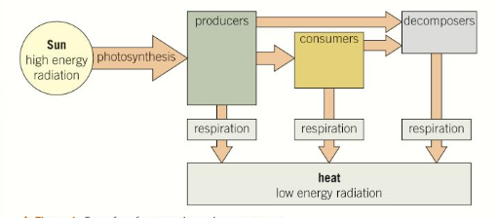

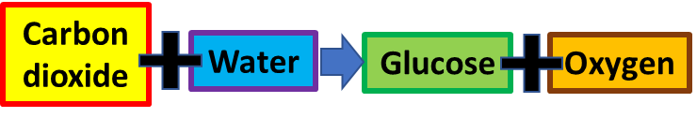
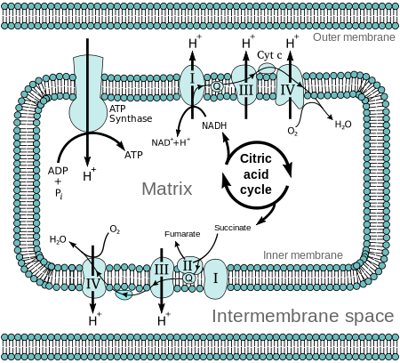
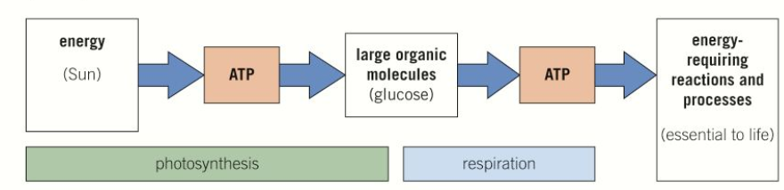
Explain the difference between photosynthesis & respiration
Explain energy flow through living organisms
Key information to include:
Where energy comes from
How energy leaves the system
The role of different organisms
Key information to include:
What respiration is
What photosynthesis is
How much ATP is produced
Where the energy comes from
What is produced
Where both take place
Describe how ATP is produced
Explain what chemiosmosis is
Key information to include:
How ATP is produced in respiration
How ATP is produced in photosynthesis
The chemical formula for the production of ATP
Where inorganic phosphates come from
Key information to include:
What chemiosmosis is
What is made
The movement of ions
Concentration gradients
The citric acid cycle

Slide 2
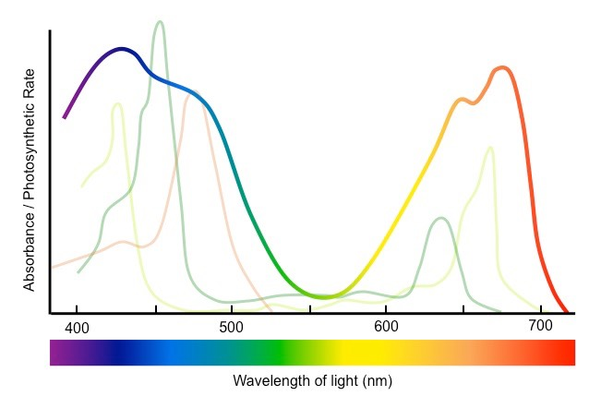
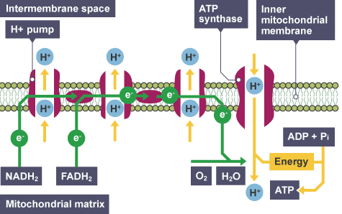
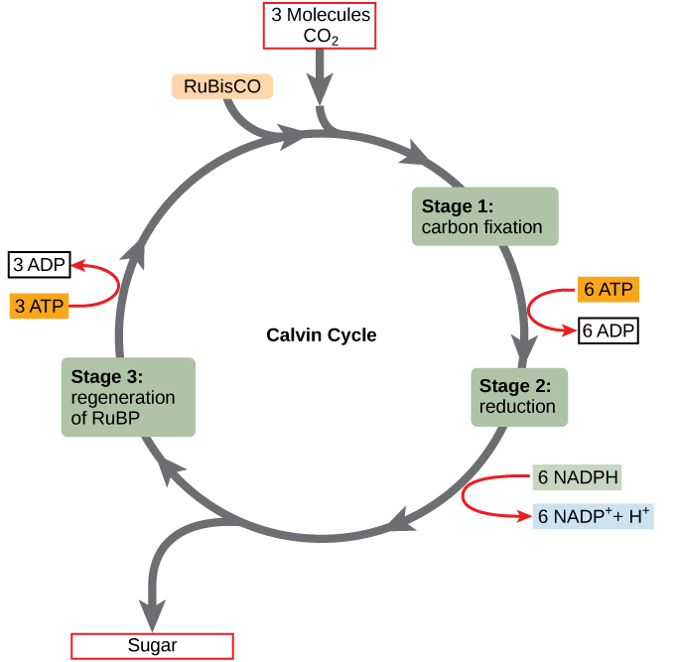
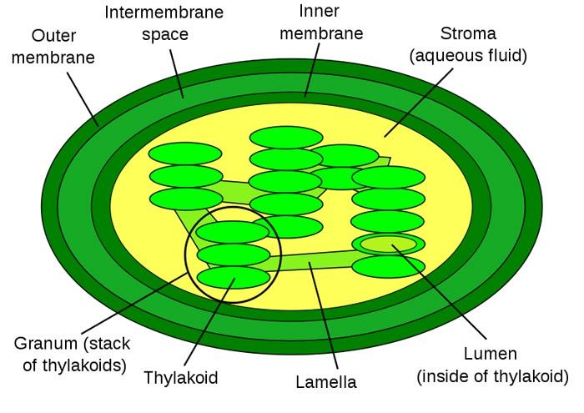
Explain the properties of chlorophyll
Explain the electron transport chain
Key information to include:
What the electron transport chain is
How electrons are moved through it
How ATP is synthesised
Key information to include:
What chlorophyll is
What it is made up of
The wave lengths of light it absorbed
How the concentrations of chlorophyll pigments change in different plants
Describe the structure of a chloroplast
Explain the process of light independent photosynthesis
Key information to include:
Describe the outer membrane
Describe the inner membrane
Describe the thylakoids
Describe the granum
Explain what happens in the lumen
Explain what happens in the stroma
Key information to include:
What light independent is
Where it takes place
The role of ATP
The role of RuBisCo
The role of GP
The role of TP
The role of NADPH

Slide 3
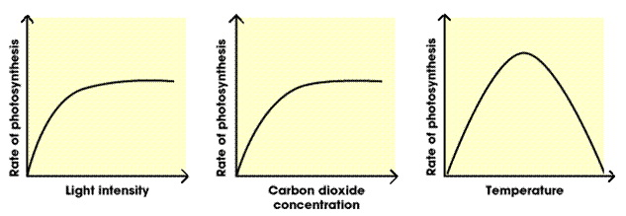
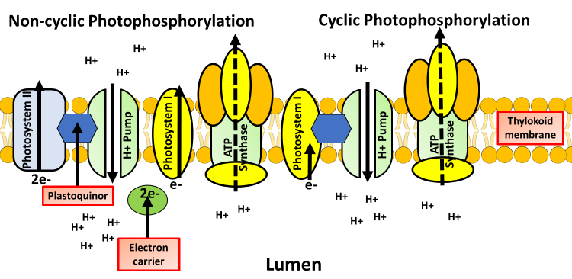
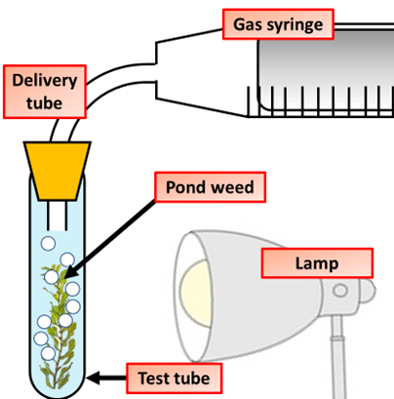
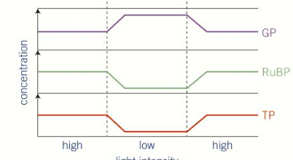
Explain the factors that effect photosynthesis
Explain light dependent photosynthesis
Key information to include:
What is a limiting factor?
What effect does light intensity have on photosynthesis?
What effect does carbon dioxide have on photosynthesis?
What effect does temperature have on photosynthesis?
Key information to include:
What happens to electrons
How ATP is synthesised
How NADPH is synthesised
Describe how rate of photosynthesis can be investigated
Explain how changing light intensity effects the Calvin cycle
Key information to include:
Summarise how the equipment is used
What is the independent, dependent & control variables
Why do you repeat it 3 times
What might cause errors in the results
How could the method be improved
Key information to include:
What the Calvin cycle is
The effect on GP
The effect on RuBP
The effect on TP

