Slide 1
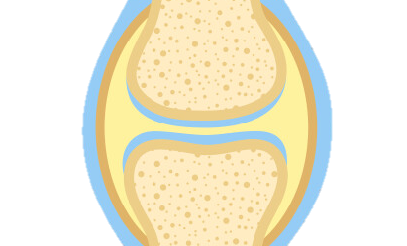
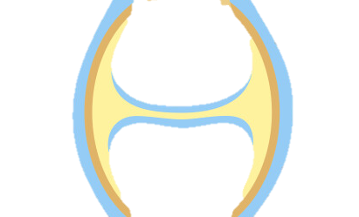





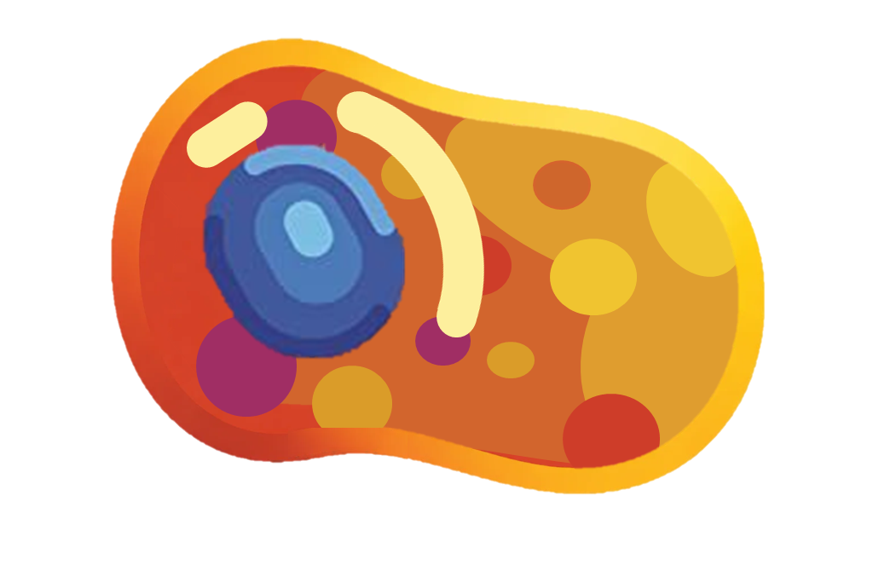







The Development Rheumatoid arthritis
Inflammatory response – The immune attack triggers the release of inflammatory chemicals (cytokines), causing swelling and redness in the synovial membrane of the joint.
Immune system malfunction – The immune system mistakenly recognises components of the body’s own joint tissues as foreign antigens.
T Cell
Cytokines
Joint damage – The pannus tissue releases enzymes that gradually break down cartilage and bone, leading to pain, stiffness, reduced mobility, and joint deformity over time.
Macrophage
Self Antibodies
Self antigens
Mast Cells
Activation of immune cells – Immune cells, particularly T cells and B cells, become activated and begin targeting the lining of the joints.
B Cell
Autoantibody production – B cells produce autoantibodies that attack the body’s own tissues.
Synovial membrane thickening – The synovial lining becomes inflamed and thickened, forming abnormal tissue called pannus.
Joint

Slide 2
The Development Rheumatoid arthritis
Inflammatory response –
Immune system malfunction –
T Cell
Cytokines
Joint damage –
Macrophage
Self Antibodies
Self antigens
Mast Cells
Activation of immune cells –
B Cell
Autoantibody production –
Synovial membrane thickening –
Joint

