Slide 1
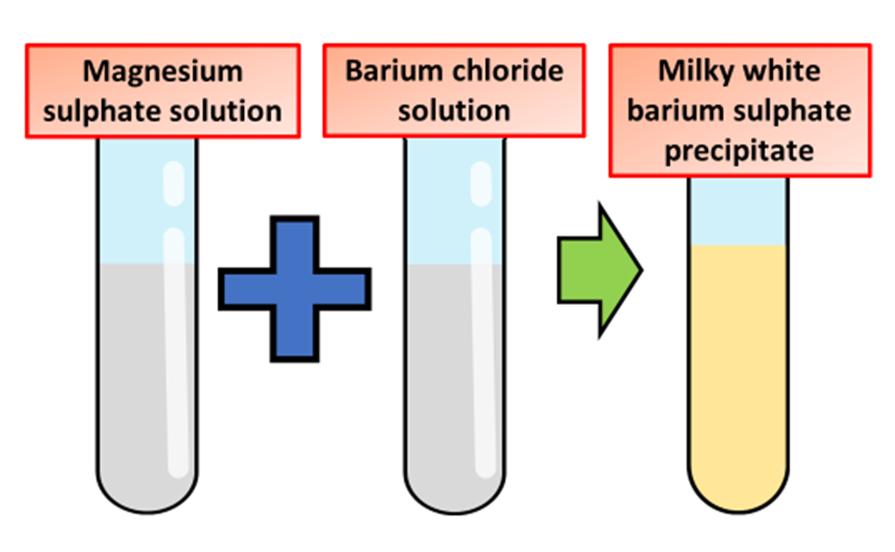
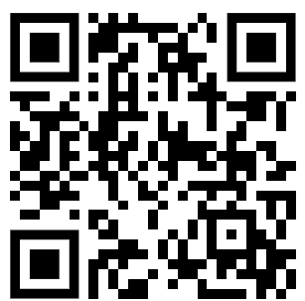
Identification of Sulfates Question
Describe how to identify sulfate ions in a solution using a chemical test. Include the observations.
______________________________________________________________________________________________________________________________________________________________________________________________________________________________________________________________________________________________________________________________________________________________________________________________________________________________________________________________________________
Answer
Link to video

