Slide 1

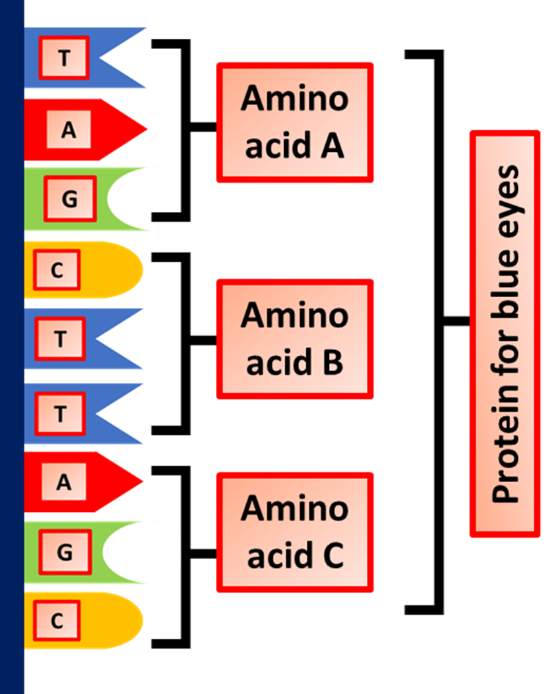

The Great Biology Pubish Quiz
Genes

Slide 2

The Great Biology Pubish Quiz
Genes
What is the functional unit of heredity?
A
Chromosome
Gene
B
C
Allele
D
Protein

Slide 3
The Great Biology Pubish Quiz
Genes
What is the process by which DNA is copied into mRNA?
A
Transcription
Translation
B
C
Replication
D
Mutation

Slide 4
The Great Biology Pubish Quiz
Genes
Which part of a gene is responsible for coding for a protein?
A
Promoter
Intron
B
C
Exon
D
Operator

Slide 5
The Great Biology Pubish Quiz
Genes
What term describes a version of a gene?
A
Allele
Locus
B
C
Genome
D
Phenotype

Slide 6
The Great Biology Pubish Quiz
Genes
What regulates the expression of a gene by controlling transcription?
A
Ribosome
mRNA
B
C
Polypeptide
D
Operon

Slide 7
The Great Biology Pubish Quiz
Genes
Which of the following is a method used to study gene expression?
A
Gel electrophoresis
B
Polymerase Chain Reaction (PCR)
C
Northern blotting
D
Western blotting

Slide 8

The Great Biology Pubish Quiz
Genes
Question 1
B
Question 2
A
Question 3
C
Question 4
A
Question 5
D
Question 6
C

