Slide 1
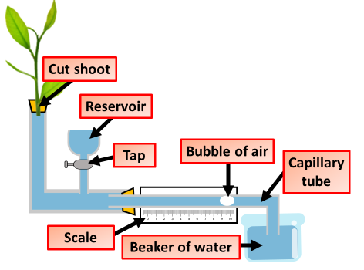

Potometer Question
The diagram below shows a potometer. Describe how you would set up an investigation to measure the rate of transpiration in a plant using a potometer.
____________________________________________________________________________________________________________________________________________________________________________________________________________________________________________________________________________________________________________________________________________________________________________________________________________________________________________________________________________________________________________________________________________________________________________________
Answer
Video link

