Slide 1
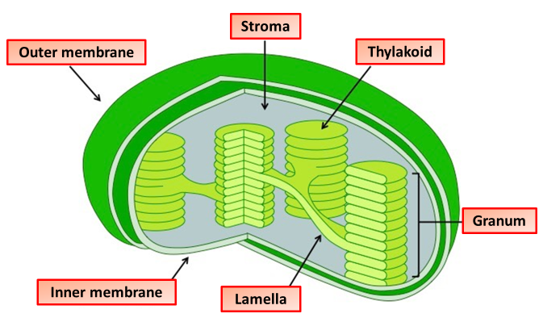
The Great Biology Pubish Quiz
Chloroplasts

Slide 2
The Great Biology Pubish Quiz
Chloroplasts
What is the main site of the light-dependent reactions in a chloroplast?
A
Stroma
Inner membrane
B
C
Outer membrane
D
Thylakoid membrane

Slide 3
The Great Biology Pubish Quiz
Chloroplasts
What is the fluid-filled space inside the chloroplast called?
A
Matrix
Cytoplasm
B
C
Stroma
D
Thylakoid

Slide 4
The Great Biology Pubish Quiz
Chloroplasts
What is a stack of thylakoids called?
A
Granum
Stroma
B
C
Lumen
D
Lamella

Slide 5
The Great Biology Pubish Quiz
Chloroplasts
What pigment is found in the thylakoid membrane?
A
Carotene
Chlorophyll
B
C
Xanthophyll
D
Phycobilin

Slide 6
The Great Biology Pubish Quiz
Chloroplasts
What connects grana in the chloroplast?
A
Stroma
Cristae
B
C
Intermembrane space
D
Lamellae

Slide 7
The Great Biology Pubish Quiz
Chloroplasts
What is the primary function of chloroplasts?
A
Photosynthesis
B
Respiration
C
Protein synthesis
D
Fermentation

Slide 8
The Great Biology Pubish Quiz
Chloroplasts
Question 1
D
Question 2
C
Question 3
A
Question 4
B
Question 5
D
Question 6
A

