Slide 1

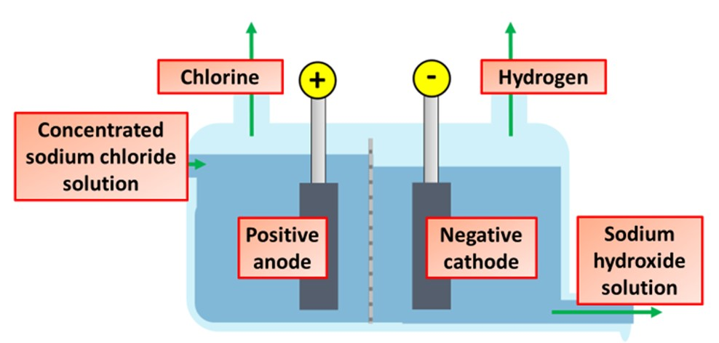
Electrolysis of Brine Question
The diagram below shows the electrolysis of brine
Video link
What is brine?
What gas is produced at the positive electrode (anode) during the electrolysis of brine?
What gas is produced at the negative electrode (cathode) during the electrolysis of brine?
What useful solution is left behind after the electrolysis of brine?

