Slide 1
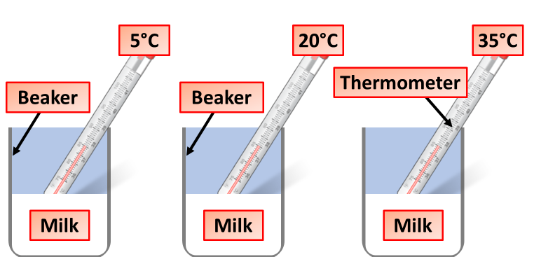
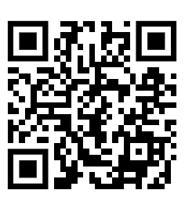
Decay Practical Practice Question
A number of different factors can affect the rate of decay
Plan an investigation into the effect of temperature on the rate of decay of fresh milk by measuring pH change.
Key things to include:
Dependent variables
Independent variables
Control variables
_______________________________________________________________________________________________________________________________________________________________________________________________________________________________________________________________________________________________________________________________________________________________________________________________________________________________________
Answer
Link to video

Slide 2
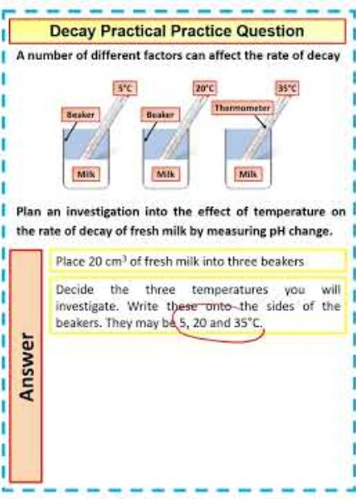
Decay Practical Practice Question

