Slide 1
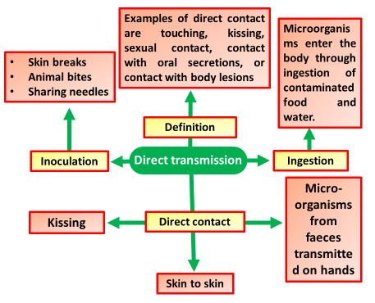

Direct Transmission Question
Describe the process of direct disease transmission and provide examples of how it occurs.
____________________________________________________________________________________________________________________________________________________________________________________________________________________________________________________________________________________________________________________________________________________________________________________________________________________________________________________________________________________________________________________________________________________________________________________
Answer
Video link

