Slide 1

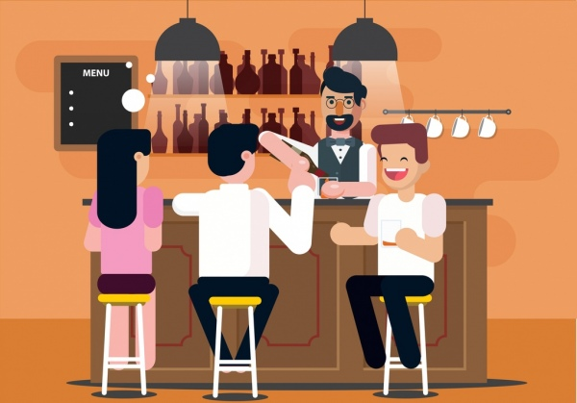
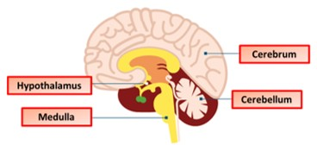
The Great Biology Pubish Quiz
The Brain

Slide 2
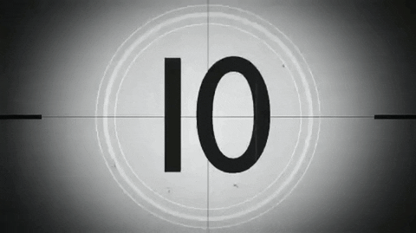
The Great Biology Pubish Quiz
The Brain
Which region of the brain is primarily responsible for regulating breathing and heart rate?
A
Cerebellum
Hypothalamus
B
C
Medulla
D
Thalamus

Slide 3
The Great Biology Pubish Quiz
The Brain
Which part of the brain coordinates muscular movement and balance?
A
Cerebrum
Cerebellum
B
C
Hippocampus
D
Pituitary gland

Slide 4
The Great Biology Pubish Quiz
The Brain
What is the main role of the hypothalamus in the brain?
A
Language processing
Coordination of voluntary movement
B
C
Hormonal regulation and homeostasis
D
Visual information processing

Slide 5
The Great Biology Pubish Quiz
The Brain
Which part of the brain is most associated with memory formation?
A
Amygdala
Hippocampus
B
C
Medulla
D
Pons

Slide 6
The Great Biology Pubish Quiz
The Brain
The corpus callosum connects which two structures?
A
Cerebrum and cerebellum
Right and left cerebral hemispheres
B
C
Brainstem and spinal cord
D
Medulla and hypothalamus

Slide 7
The Great Biology Pubish Quiz
The Brain
Which lobe of the brain is primarily involved in processing visual information?
A
Temporal lobe
B
Frontal lobe
C
Parietal lobe
D
Parietal lobe

Slide 8

The Great Biology Pubish Quiz
The Brain
Question 1
C
Question 2
B
Question 3
C
Question 4
B
Question 5
B
Question 6
D

