Slide 1
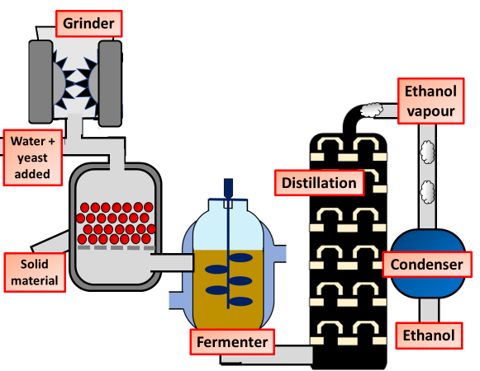
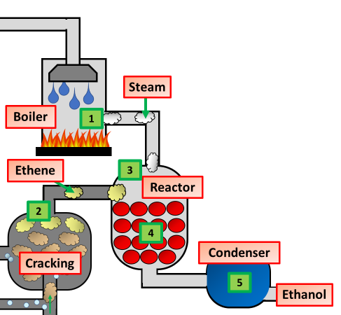
Ethanol Production Question
Specification Link:
Organic Chemistry
Highlight key words in the information below:
Fermentation is the process of converting carbohydrates to alcohol or to organic acids using microorganisms, such as yeasts or bacteria. This process takes place when there are beneficial bacteria present that break down the starch and sugars in the food.
Describe how the solution of sugar in water is used to produce the mixture of ethanol and water.
____________________________________________________________________________________________________________________________________________________
Ethanol has a boiling point of 78 °C.
Water has a boiling point of 100 °C.
Describe how distillation is used to separate a mixture of ethanol and water.
____________________________________________________________________________________________________________________________________________________
Highlight key words in the information below:
Ethanol can be manufactured by the hydration of ethene. In this reaction, ethene (which comes from cracking crude oil fractions) is heated with steam in the presence of a catalyst of phosphoric acid (to speed up the reaction)
Describe how ethanol is produced by the hydration of ethene
________________________________________________________________________________________________________________________________________________________________________________________________________________________________________________________________________________________________________________________________________________________________________________________________________________________________
Use the information in the two flow diagrams and your own knowledge and understanding to evaluate whether more of this ethanol should be produced from food crops or from crude oil.
___________________________________________________________________________________________________________________________________________________________________________________________________________________________________________________________________
Ethanol
Describe how the equipment to the left could be used to measure the rate of photosynthesis:
_______________________________________________________________________________________________________________________________________________________________________________________________________________________________________________________________

