Slide 1
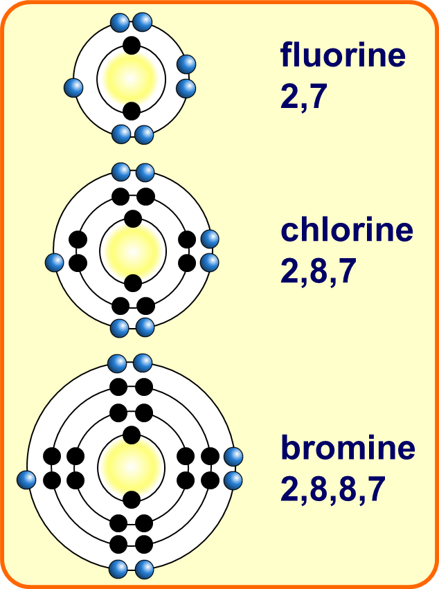

Group 7 Practice Question
Explain why chlorine is more reactive than iodine.
Key things to include:
How many electrons do group 7 elements need to gain
What effect does distance from the nucleus have
Answer
_________________________________________________________________________________________________________________________________________________________________________________________________________________________________________________________________________________________________________________________________________
Link to video

Slide 2
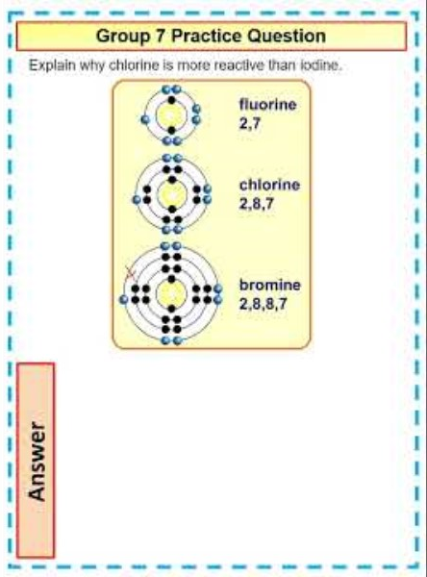
Group 7 Practice Question

