Slide 1

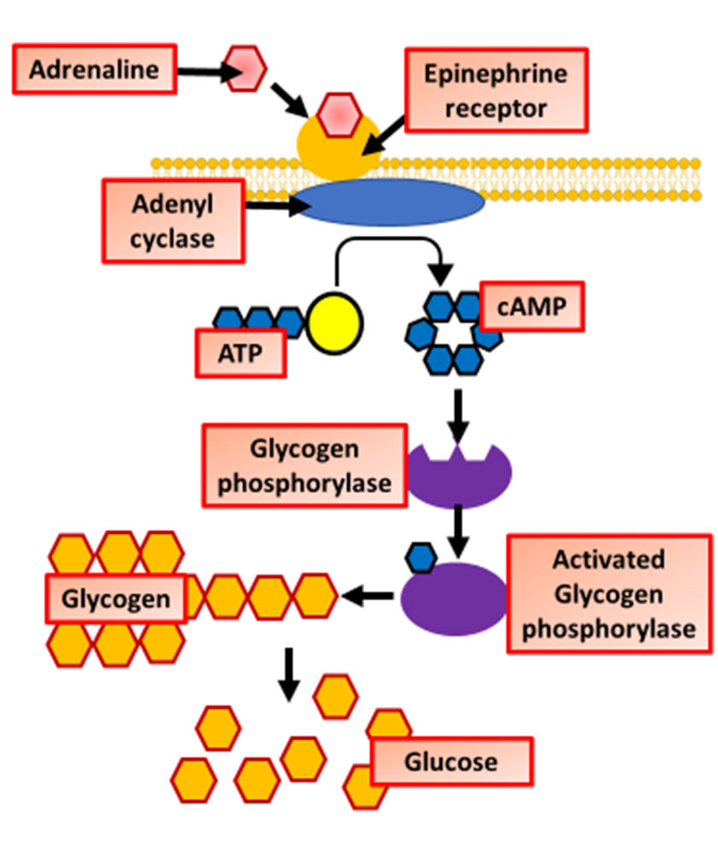
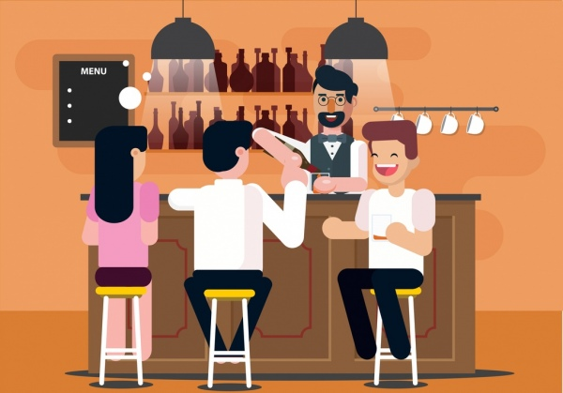
The Great Biology Pubish Quiz
Adrenaline Action

Slide 2
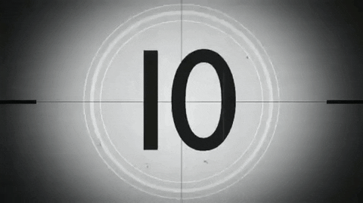
The Great Biology Pubish Quiz
Adrenaline Action
Which type of molecule does adrenaline bind to on the target cell surface?
A
Enzyme
Receptor
B
C
Protein
D
Transporter

Slide 3
The Great Biology Pubish Quiz
Adrenaline Action
What is the name of the second messenger activated by adrenaline binding?
A
Glycogen
Kinase
B
C
AMP
D
cAMP

Slide 4
The Great Biology Pubish Quiz
Adrenaline Action
Which organ is primarily stimulated by adrenaline to release glucose?
A
Brain
Liver
B
C
Pancreas
D
Kidney

Slide 5
The Great Biology Pubish Quiz
Adrenaline Action
Adrenaline action on cells is an example of which type of cell signalling?
A
Autocrine
Paracrine
B
C
Endocrine
D
Synaptic

Slide 6
Sleep
The Great Biology Pubish Quiz
Adrenaline Action
Adrenaline prepares the body for which type of response?
A
Fight
Axon
B
C
Rest
D
Digest

Slide 7
The Great Biology Pubish Quiz
Adrenaline Action
What type of reflex helps maintain posture and balance?
A
Learned
B
Cranial
C
Spinal
D
Postural

Slide 8

The Great Biology Pubish Quiz
Adrenaline Action
Question 1
B
Question 2
D
Question 3
B
Question 4
C
Question 5
A
Question 6
C

