Slide 1
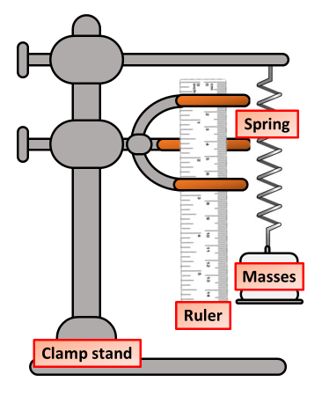

Hooke’s Law Practical Question
Describe how to carry out an experiment to investigate how a spring stretches when different forces are applied.
Key things to include:
What is the dependent variable
What is the independent variable
What are the control variables
_______________________________________________________________________________________________________________________________________________________________________________________________________________________________________________________________________________________________________________________________________________________________________________________________________________________________________
Answer
Link to video

