Slide 1
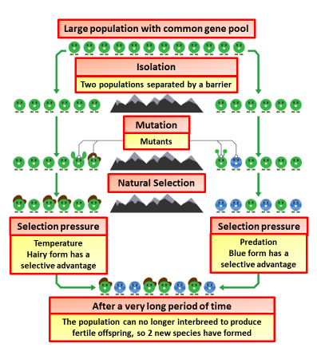

Speciation Question
The diagram shows the process of speciation
Explain the process of speciation
Key things to include:
How can members of a species be isolated
What causes variation between populations
___________________________________________________________________________________________________________________________________________________________________________________________________________________________________________________________________________________________________________________________________________________________________________________________________________________________________________________________________________________________________________________________________________________________________________________________________________________________________
Answer
Link to video

Slide 2

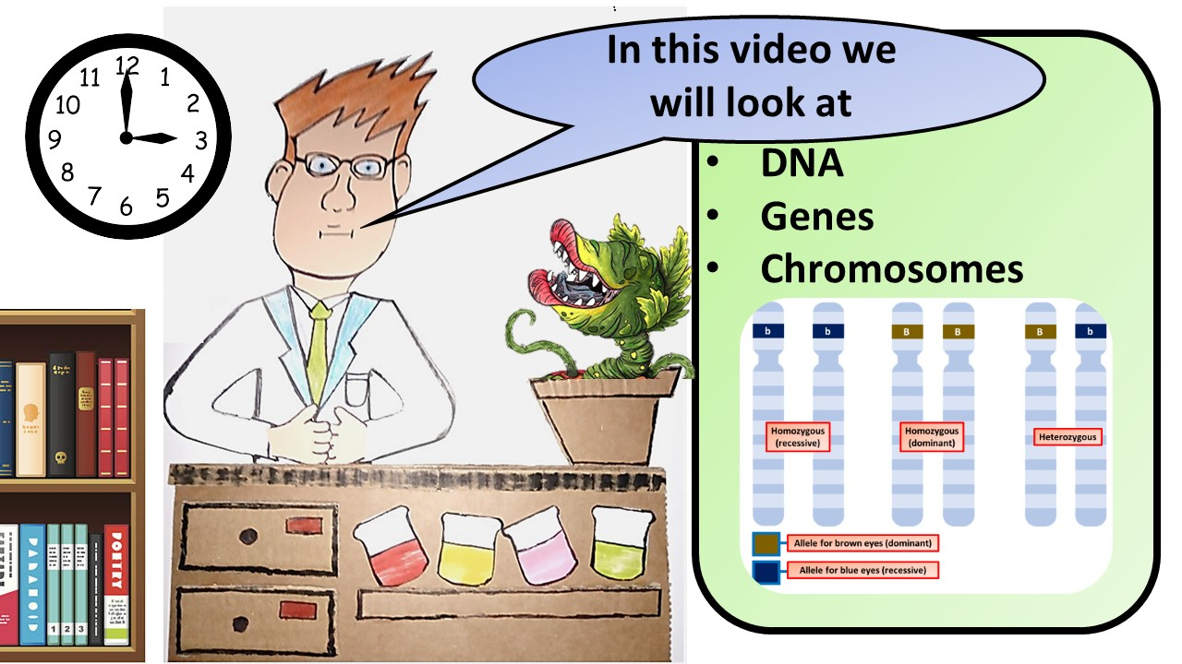


Click here to access my DNA youtube videos
Resources that this activity would work well with
Lesson on TES
Lesson on TPT
Follow me on social media to stay in touch
Keep up to date with my new content:

