Slide 1

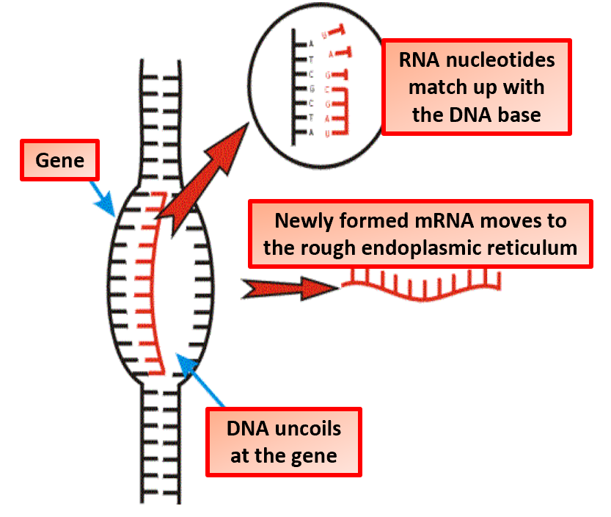

The Great Biology Pubish Quiz
Transcription

Slide 2
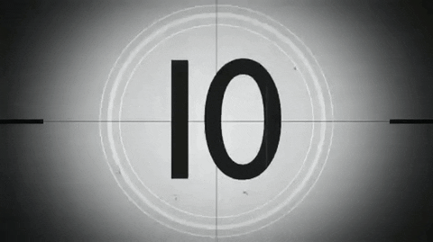
The Great Biology Pubish Quiz
Transcription
What is the enzyme responsible for transcription?
A
DNA polymerase
Helicase
B
C
Ligase
D
RNA polymerase

Slide 3
The Great Biology Pubish Quiz
Transcription
What is the template strand used for transcription called?
A
Coding strand
Sense strand
B
C
Antisense strand
D
Leading strand

Slide 4
The Great Biology Pubish Quiz
Transcription
Which molecule is produced during transcription?
A
mRNA
tRNA
B
C
rRNA
D
DNA

Slide 5
The Great Biology Pubish Quiz
Transcription
Where does transcription occur in eukaryotic cells?
A
Ribosome
Nucleus
B
C
Cytoplasm
D
Mitochondria

Slide 6
The Great Biology Pubish Quiz
Transcription
What is added to the 5' end of eukaryotic mRNA during processing?
A
Poly-A tail
Introns
B
C
5' cap
D
Exons

Slide 7
The Great Biology Pubish Quiz
Transcription
What sequence signals the end of transcription?
A
Terminator
B
Promoter
C
Enhancer
D
Operator

Slide 8

The Great Biology Pubish Quiz
Transcription
Question 1
D
Question 2
C
Question 3
A
Question 4
B
Question 5
C
Question 6
A

