Slide 1
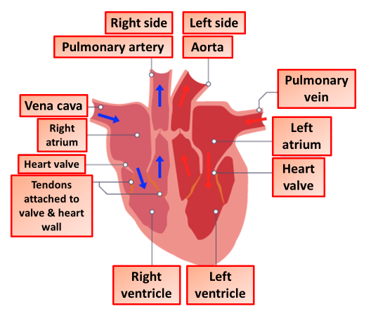

The Heart Question
The diagram shows the heart:
Video link
What is the main function of the heart?
Which blood vessel carries oxygenated blood away from the heart?
Which chamber of the heart pumps blood to the lungs?
What prevents blood from flowing backwards in the heart?

