Slide 1
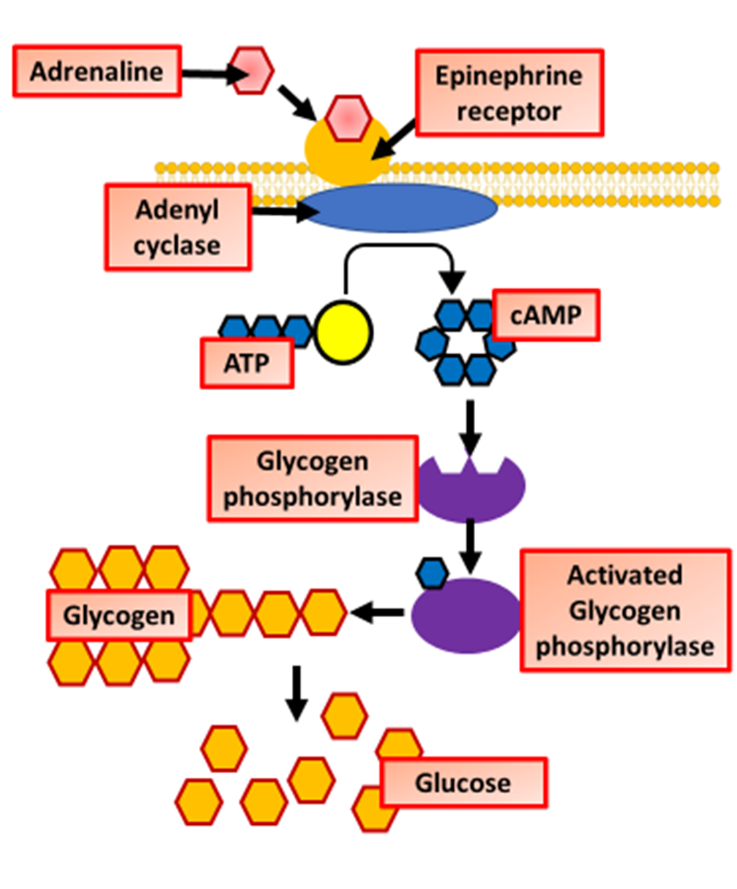

Adrenaline Action on Cells Question
The diagram below shows some of the stages of how adrenaline effects cells
Explain how adrenaline affects cells to prepare the body for a fight-or-flight response.
________________________________________________________________________________________________________________________________________________________________________________________________________________________________________________________________________________________________________________________________________________________________________________________________________________________________________________________________________________________________________________________________________________________________________________________________________________________________________________________________________________________________________________________________________________________________________________
Answer
Link to video

