Slide 1
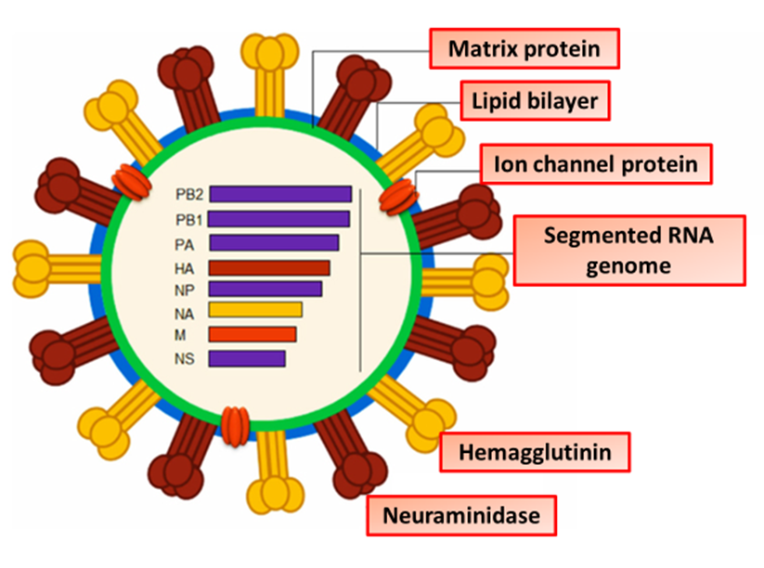

Influenza Question
Describe the cause, transmission, and effects of influenza in humans
____________________________________________________________________________________________________________________________________________________________________________________________________________________________________________________________________________________________________________________________________________________________________________________________________________________________________________________________________________________________________________________________________________________________________________________
Answer
Video link

