Slide 1
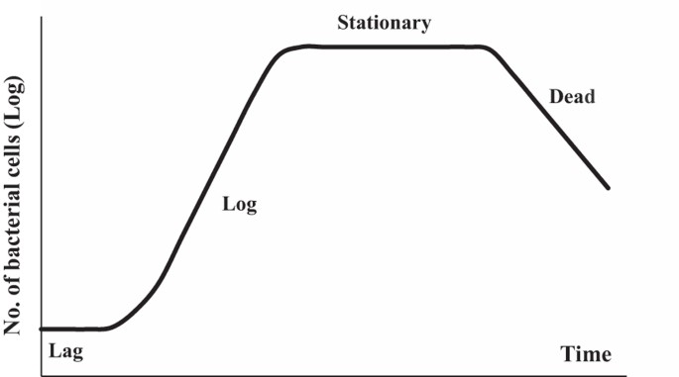

Bacterial Growth Graph Question
A student measured the population of bacteria in a culture every hour for 8 hours. The data showed rapid growth between hours 2 and 6, then a plateau.
Analyse the data and explain the changes in bacterial population over time.
____________________________________________________________________________________________________________________________________________________________________________________________________________________________________________________________________________________________________________________________________________________________________________________________________________________________________________________________________________________________________________________________________________________________________________________
Answer
Link to video

