Slide 1
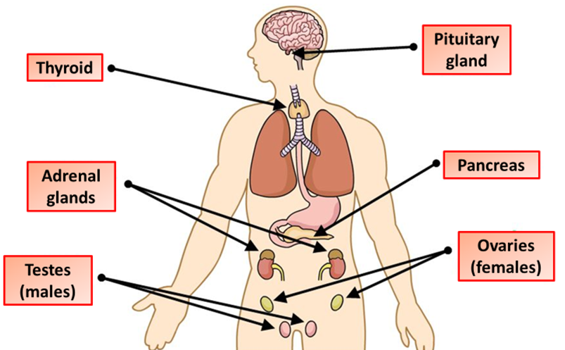

Endocrine System Question
Describe the role of the endocrine system in the human body.
Key things to include:
What hormones are
What glands are
Examples of major glands and their funtion
_______________________________________________________________________________________________________________________________________________________________________________________________________________________________________________________________________________________________________________________________________________________________________________________________________________________________________
Answer
Link to video

