Slide 1
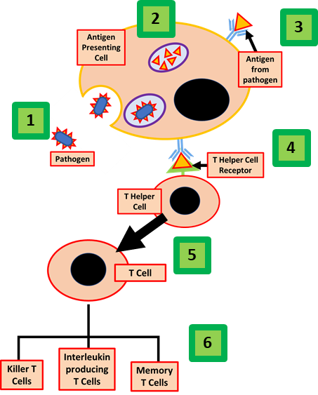

The Role of T Cells Question
The diagram shows some of the roles of T Cells. Explain the role of T Cells in immunity
____________________________________________________________________________________________________________________________________________________________________________________________________________________________________________________________________________________________________________________________________________________________________________________________________________________________________________________________________________________________________________________________________________________________________________________
Answer
Link to video

Slide 2

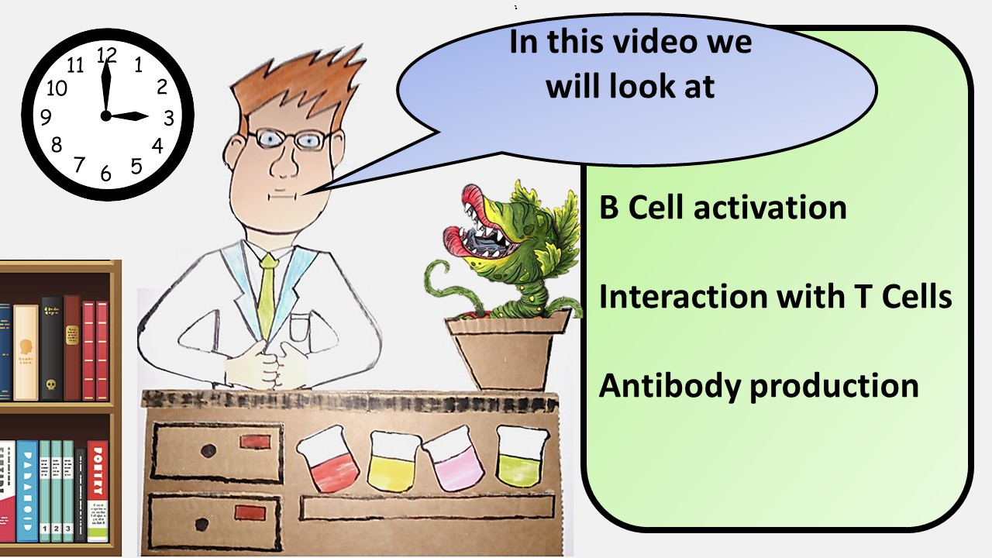


Click here to access my immunity youtube videos
Resources that this activity would work well with
Lesson on TES
Lesson on TPT
Follow me on social media to stay in touch
Keep up to date with my new content:

