Slide 1
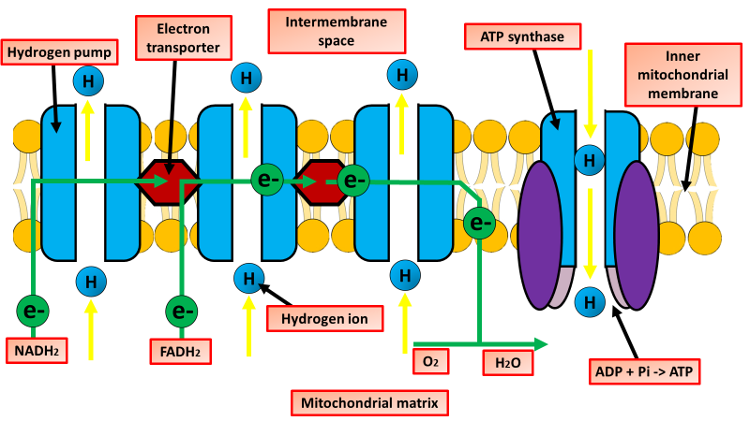

ATP Synthesis Question
Describe how ATP is synthesised during the electron transport chain in aerobic respiration.
____________________________________________________________________________________________________________________________________________________________________________________________________________________________________________________________________________________________________________________________________________________________________________________________________________________________________________________________
Answer
Video link

