Slide 1
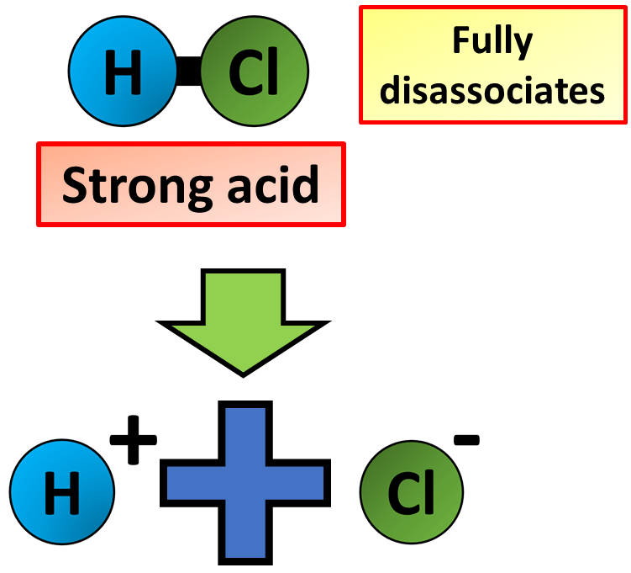
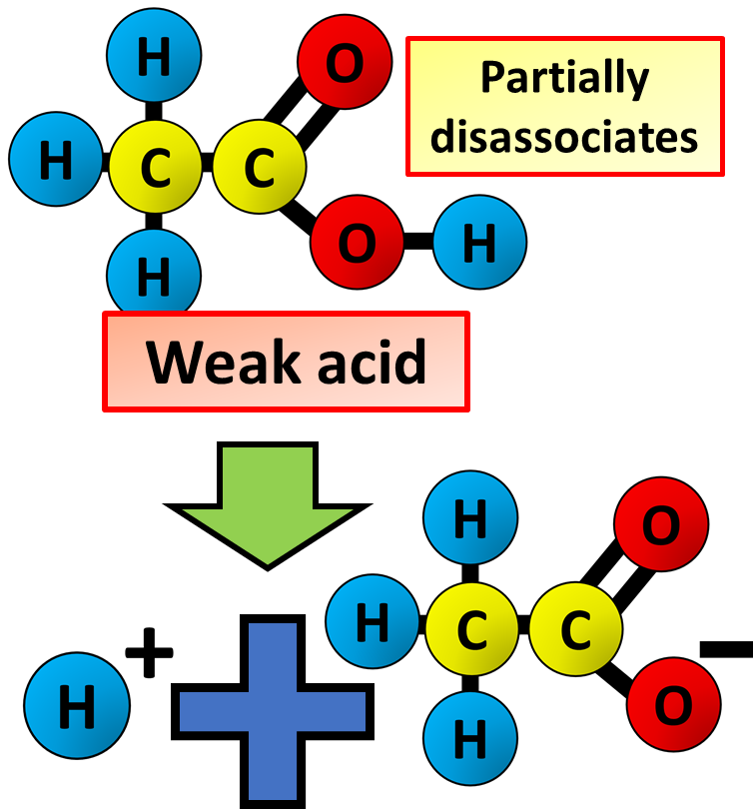

Strong & Weak Acids Question
Describe the differences between strong acids and weak acids in terms of ionisation and pH.
Key things to include:
How do they both disassociate
What effect does this have on available hydrogen ions
_______________________________________________________________________________________________________________________________________________________________________________________________________________________________________________________________________________________________________________________________________________________________________________________________________________________________________
Answer
Link to video

