Slide 1
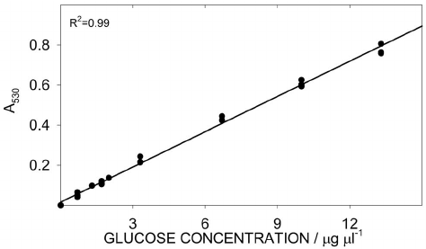

The Use of a Calibration Curve Question
Explain why a calibration curve is needed when determining the concentration of glucose using a colorimeter.
____________________________________________________________________________________________________________________________________________________________________________________________________________________________________________________________________________________________________________________________________________________________________________________________________________________________________________________________________________________________________________________________________________________________________________________
Answer
Link to video

