Slide 1
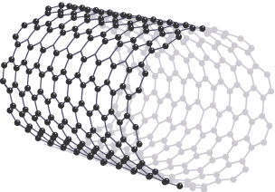
Fullerene Practice Question
A fullerene is a form of carbon molecule where carbon atoms are arranged in a hollow, cage-like structure, often resembling a sphere or tube.
Describe what fullerenes are, their structure, and some of their uses.
Key things to include:
How many bonds do carbon atoms form
What shapes do the carbon atoms make
What are the properties of the fullerene
What can they be used for
_____________________________________________________________________________________________________________________________________________________________________________________________________________________________________________________________________________________________________________________________________________________________________________________________________________________________________________________________________________________________________________________________________
Answer
Link to video

Slide 2
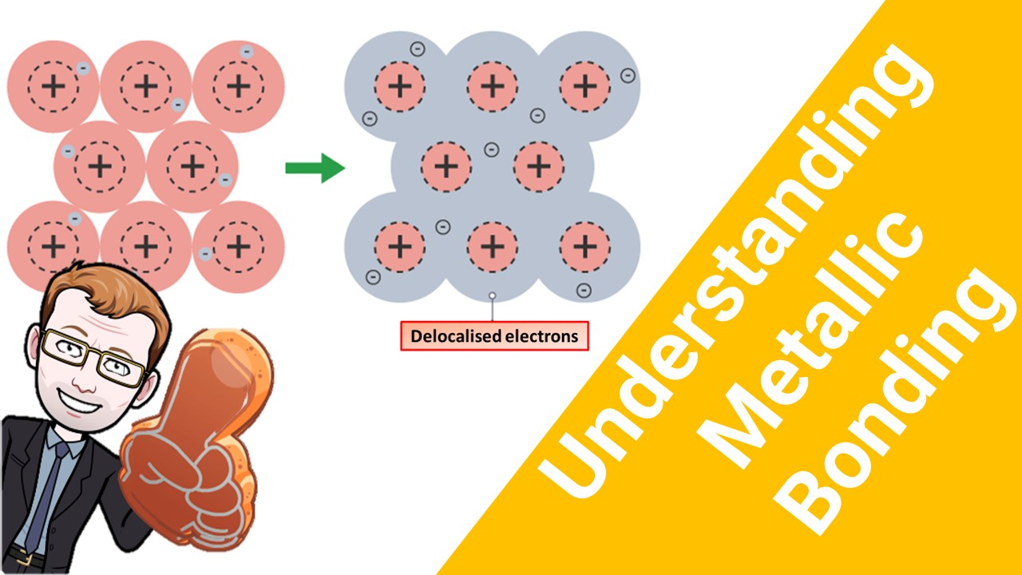
Click here to access my bonding youtube videos
Resources that this activity would work well with
Lesson on TES
Lessons on TPT
Follow me on social media to stay in touch
Keep up to date with my new content:

