Slide 1
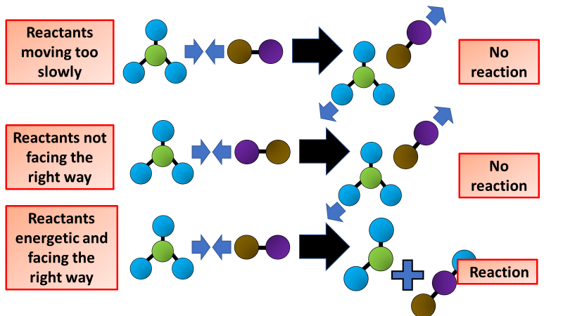

Collision Theory Question
The diagram below shows some information about collision theory. Explain how collision theory describes the factors that affect the rate of a chemical reaction
Key things to include:
How does temperature affect collisions
How does temperature affect collisions
How does a catalyst affect collisions
_______________________________________________________________________________________________________________________________________________________________________________________________________________________________________________________________________________________________________________________________________________________________________________________________________________________________________
Answer
Link to video

