Slide 1
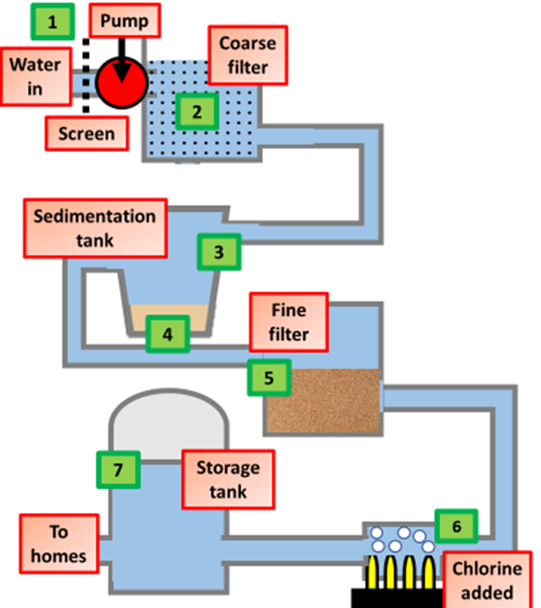
Water Treatment Question
The diagram below shows the stages of water treatment. Describe the main stages involved in treating water to make it safe for drinking.
Key things to include:
What is the role of filtering
What is the role of sedimentation
What is the role of chlorination
_______________________________________________________________________________________________________________________________________________________________________________________________________________________________________________________________________________________________________________________________________________________________________________________________________________________________________
Answer
Link to video

