Slide 1
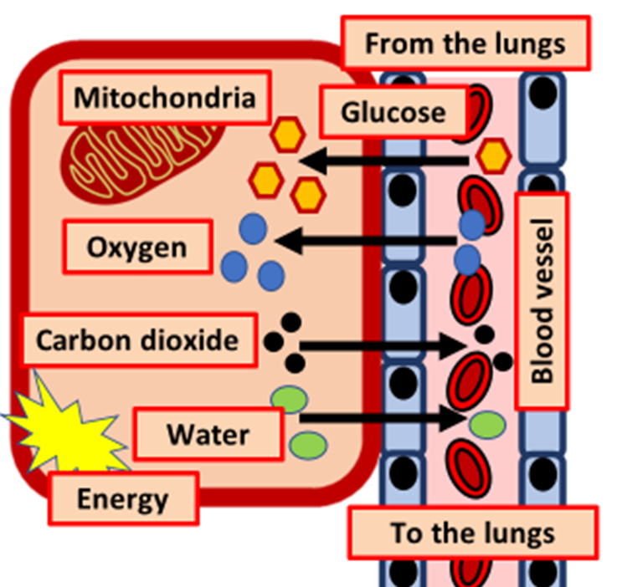

Respiration Question
The diagram shows some of the processes involved in respiration
Video Link
What is aerobic respiration?
Where does aerobic respiration take place in the cell?
Which gas is required for aerobic respiration?
What are the waste products from respiration?

