Slide 1
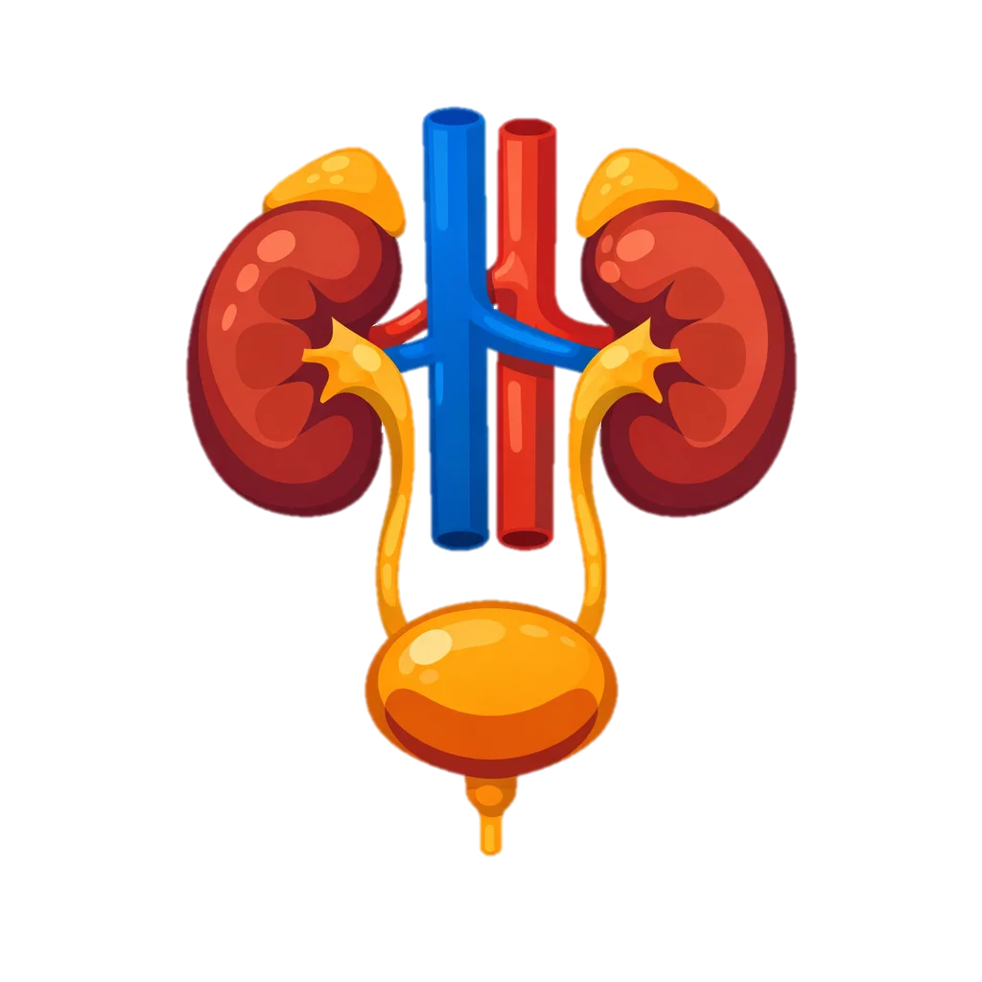
The Renal System
Blood enters the kidneys through the renal artery and flows into millions of tiny filtering units called Nephron.
Large molecules, such as proteins and blood cells, are too big to pass through the filter and remain in the blood.
Renal vein
Kidney
Ultrafiltration occurs in the glomerulus, where high pressure forces small molecules such as water, glucose, salts and urea out of the blood into the nephron.
Renal Artery
Selective reabsorption takes place in the kidney tubules, where useful substances like glucose, some salts and most of the water are reabsorbed back into the blood.
Urine flows from the kidneys to the bladder through the Ureter, where it is stored before leaving the body through the Urethra.
Waste products remain, including urea and excess water or salts, forming urine.
Bladder

Slide 2
Blood enters the kidneys
Large molecules,
Renal vein
Kidney
Ultrafiltration occurs
Renal Artery
Selective reabsorption takes place
Urine flows from the kidneys to the bladder
Waste products remain,
Bladder

