Slide 1
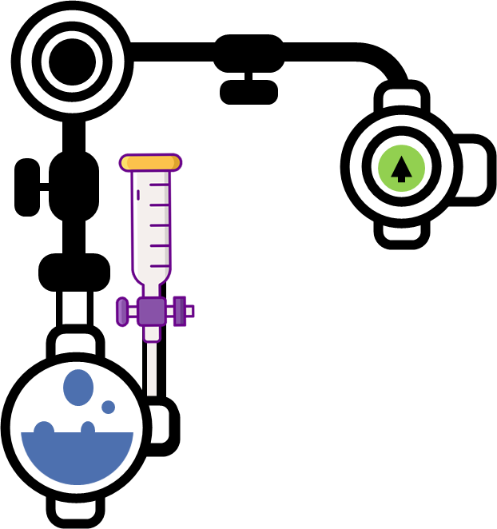
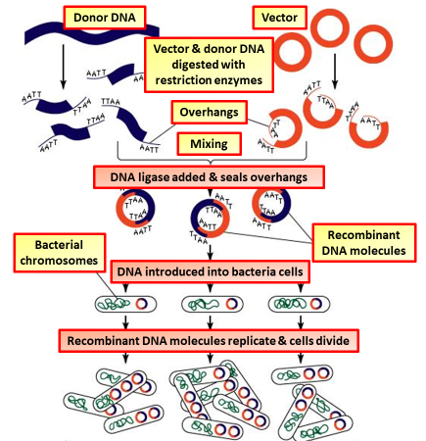
Manipulating Genomes Notes
Selective breeding involves choosing parents with particular characteristics to breed together and produce offspring with more desirable characteristics. Humans have selectively bred plants and animals for thousands of years including: crop plants with better yields
new varieties may be economically important, by producing more or better quality food.
animals can be selected that cannot cause harm, for example cattle without horns.
Adult Cell Cloning
Fusion cell cloning involves replacing the nucleus of an unfertilised egg with the nucleus from a different cell. The replacement nucleus can come from an embryo, but if it comes from an adult cell, it is called adult cell cloning. Here’s how she was produced:
An egg cell was removed from the ovary of an adult female sheep, and its nucleus removed.
The nucleus from an udder cell of a donor sheep was inserted into the empty egg cell.
The fused cell then began to develop normally, using genetic information from the donated DNA.
Before the dividing cells became specialised, the embryo was implanted into the uterus of a foster mother sheep
The cell that you want to extract the gene out of is identified
The chromosome (DNA) is extracted from the nucleus of that cell
The specific gene is identified on the chromosome and cut out using restriction enzymes
Bacteria is used to produce insulin
The plasmid from a bacteria cell is extracted
The plasmid is cut open using a restriction enzyme
The gene for insulin is stuck into the plasmid using an enzyme
The plasmid is re-inserted back into the bacteria
The bacterium now has the gene to produce human insulin
The bacterium is grown in a fermenter
At pH7, 35ºC & with the correct levels of nutrients and oxygen
As the bacteria replicate they produce insulin
The insulin is then extracted & purified

Slide 2
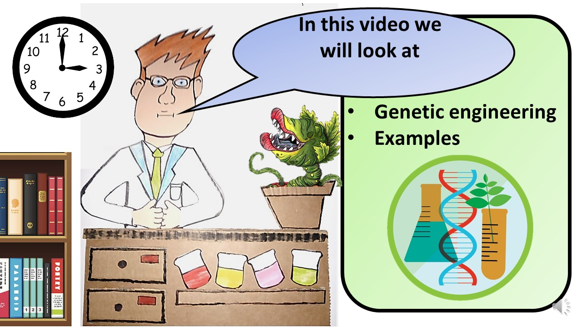
Click here to access my genetic engineering youtube video
Resources that this activity would work well with
Lesson on TES
Lesson on TPT
Follow me on social media to stay in touch
Keep up to date with my new content:

