Slide 1
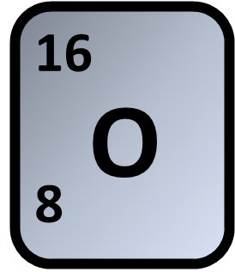
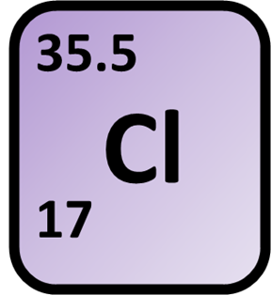
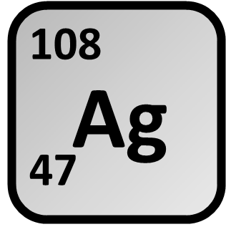
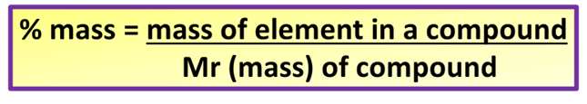
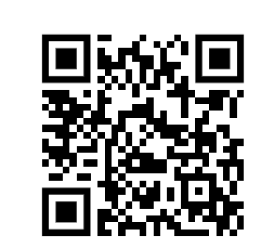
Percentage Composition
Calculate the percentage of Oxygen (O) in AgClO3
Calculate the mass of the atom
Calculate the mass of the compound
Answer
Calculate the percentage
Link to answer video

Slide 2

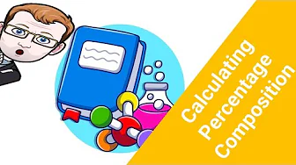


Click here to access my percentage composition youtube videos
Resources that this activity would work well with
Lesson on TES
Percentage Mass Calculation Révision Questions on TES
Follow me on social media to stay in touch
Keep up to date with my new content:

