Slide 1
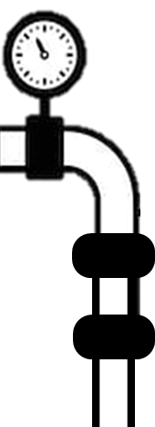

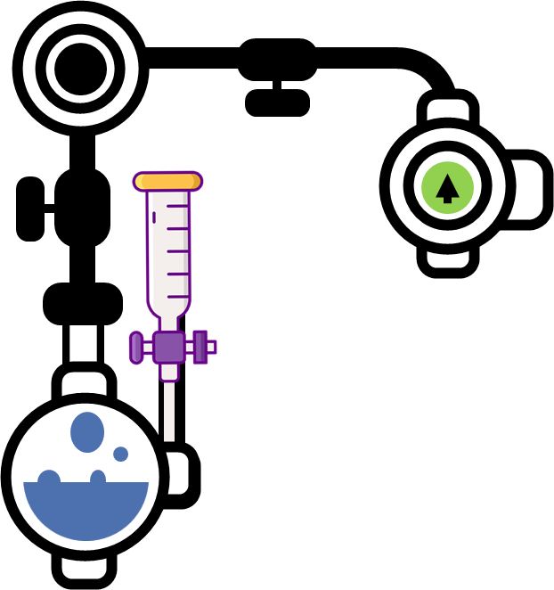

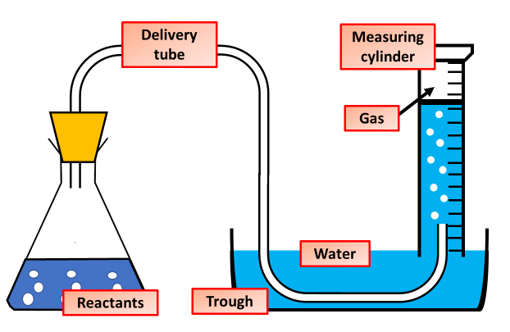
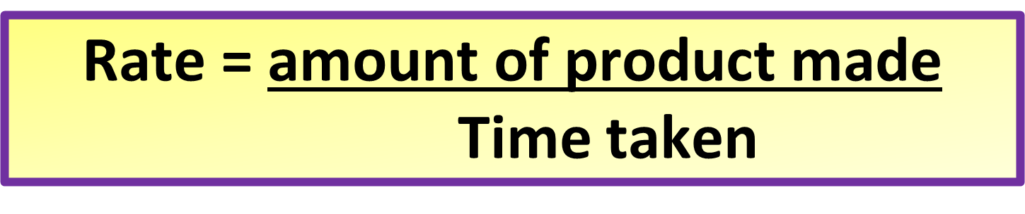
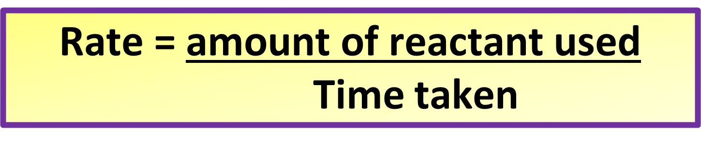
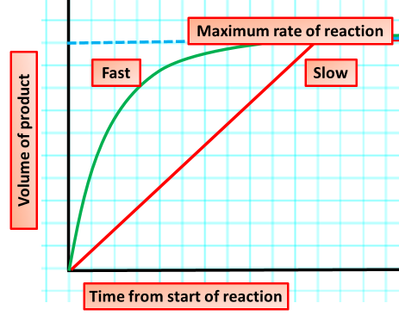
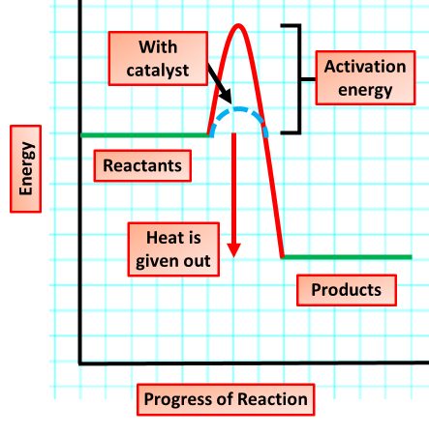
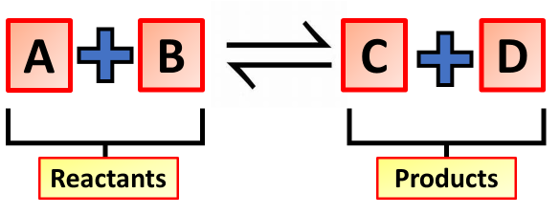
Rate of Reaction Notes
The reaction rate or rate of reaction is the speed at which a chemical reaction takes place. Reaction rate is defined as the speed at which reactants are converted into products
Collision theory states that for a chemical reaction to occur, the reacting particles must collide with one another. The rate of the reaction depends on the frequency of collisions. The theory also tells us that reacting particles often collide without reacting
Measuring Rate of Reaction
The change in volume of a reactant or product can be followed during a reaction. This method is useful when a gas leaves the reaction container. The volume of a gas is measured using a gas syringe, or an upside down burette or measuring cylinder.
The rate of a chemical reaction can be raised by increasing the surface area of a solid reactant. This is done by cutting the substance into small pieces, or by grinding it into a powder. If the surface area of a reactant is increased: more particles are exposed to the other reactant.
The rate of a chemical reaction can be changed by altering the temperature. If the temperature is increased: the reactant particles move more quickly, they have more energy, the particles collide more often, and more of the collisions are successful, the rate of reaction increases
Concentration. If you increase the concentration of a reactant, there will be more of the chemical present. More reactant particles moving together allow more collisions to happen and so the reaction rate is increased. The higher the concentration of reactants, the faster the rate of a reaction will be.
Catalysts only affect the rate of reaction - they do not affect the yield of the reaction. A catalysed reaction produces the same amount of product as an uncatalysed reaction but it produces the product at a faster rate.
Reversible reactions are different. In a reversible reaction, the products can react to produce the original reactants again.

Slide 2
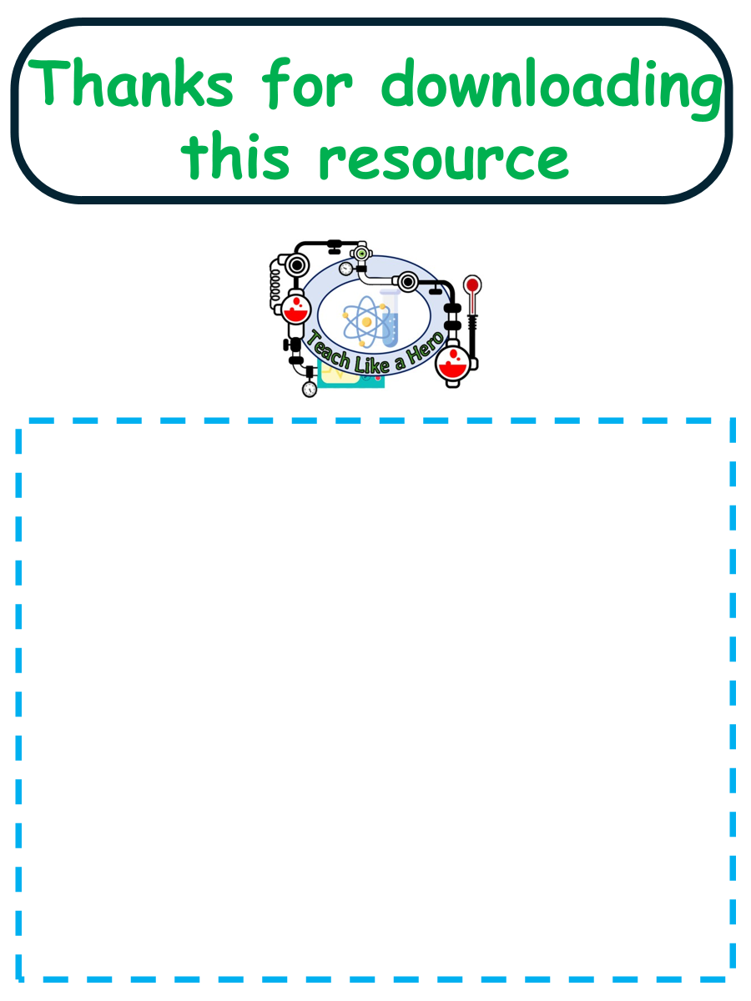
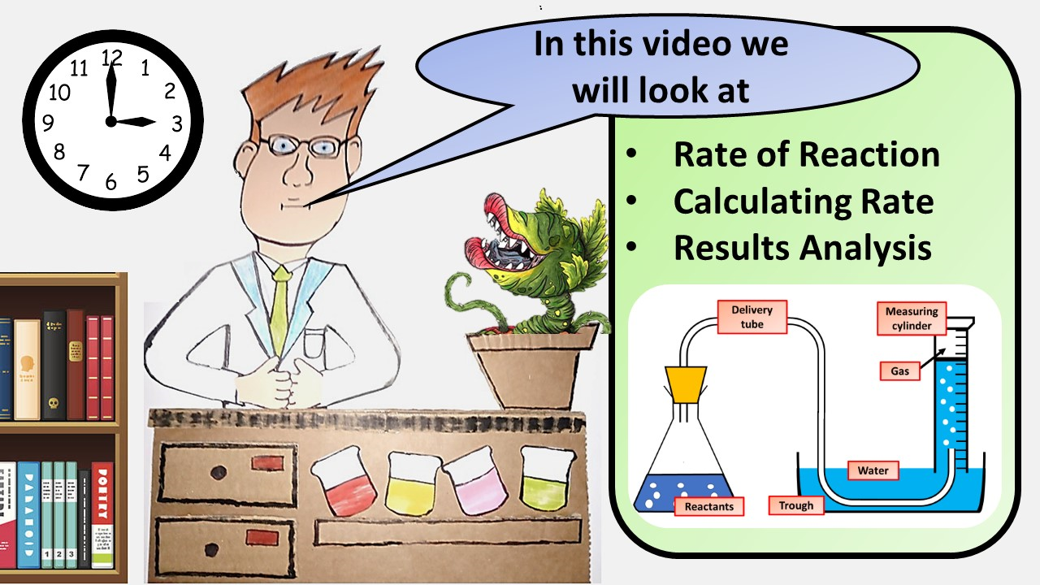


Click here to access my rate of reaction youtube videos
Resources that this activity would work well with
Lessons on TPT
Lessons on TES
Follow me on social media to stay in touch
Keep up to date with my new content:

