Slide 1
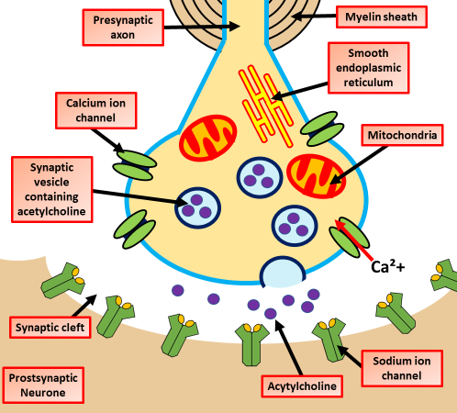
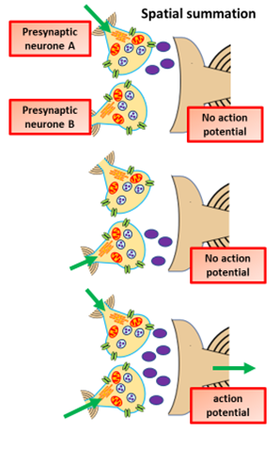
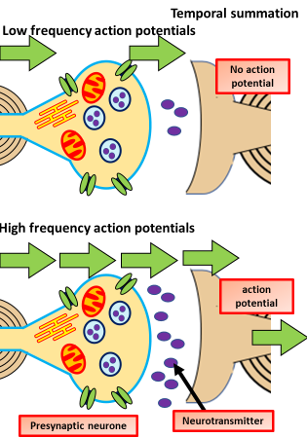
Synapse Question
Specification Link:
Biological Molecules
The diagram to the right shows the structure of a synapse. Describe in detail how nerve impulses are transmitted across a synapse:
______________________________________________________________________________________________________________________________________________________________________________________________________________________________________________________________________________________________________________________________________________________________________________________________________________________________________________________________________________________________________________________________
Spatial summation is a way of achieving an action potential in a neuron with input from multiple presynaptic cells. Spatial summation is the algebraic summation of potentials from different areas of input, usually on the dendrites.
Where is the axon potential initiated?
__________________________________________________________________________________________________________________
What is the frequency of action potentials in temporal summation?
__________________________________________________________________________________________________________________
Describe temporal summation
__________________________________________________________________________________________________________________
Temporal summation is where a high frequency of action potentials in the presynaptic neuron elicits postsynaptic potentials that overlap and summate with each other. The effect is generated by a single neuron as a way of achieving action potential.
What does the neuronal cell act like?
____________________________________________________________________________
Describe spatial summation
________________________________________________________________________________________________________________________________________________________________________________________________________________________________________________________________________________________
How many nerve cells does spatial summation involve?
____________________________________________________________________________

Slide 2



Click here to access my percentage composition youtube videos
Resources that this activity would work well with
Lesson on TES
Lesson on TPT
Follow me on social media to stay in touch
Keep up to date with my new content:

