Slide 1
GCSE 1-9 Science Key Things to Remember: Writing a Hypothesis
Your hypothesis needs to explain what you think is going to happen in your practical and why.
Key words & concepts:
Dependent
Independent
How they are connected
What do you think is going to happen?
What variables are you going to look at?
Why do you think it is going to happen?

Slide 2
GCSE 1-9 Science Key Things to Remember: Risk Assessment
Your risk assessment is worth between 1-3 marks in your method depending on how much detail you put in. You need to concentrate on just one risk and do it well rather than a few done with little detail
Your risk assessment should include:
What the risk is
What precautions you can take
What the level of risk is
Key words & concepts:
Risk
High, medium or low risk
I can lower this risk by…….

Slide 3
GCSE 1-9 Science Key Things to Remember: Variables
In your practical there will be variables that you will need to talk about.
An independent variable is what you change
A dependent variable is what you measure
A control variable is what you need to keep the same to make it a fair test
Key words & concepts:
On a graph the independent is along the bottom & the dependent is down the side

Slide 4
GCSE 1-9 Science Key Things to Remember: Comparing results
In your practical you will carry out the experiment once then compare results with other students. This will enable you to get 3 results for each independent variable
Key words & concepts
Anomalies
Average (how do you work it out)
Pattern in the results
Reproducible
Things to think about
Why do we compare results?
How many of each result do we get?
Why might peoples results differ?

Slide 5
GCSE 1-9 Science Key Things to Remember: Problems with Equipment
Any indication that a measuring system gives a false reading when the true value of a measured quantity is zero, e.g. the needle on an ammeter failing to return to zero when no current flows. A zero error may result in a systematic uncertainty.
Key words & concepts
Zero error
Start reading
Subtract
Replace equipment
Things to include
What is a zero error
How can we account for it

Slide 6
GCSE 1-9 Science Key Things to Remember: Independent Variable
In your practical there will be variables that you will need to take about. An independent variable is what you change.
Things to include
What was your independent variable?
What was the interval of your independent variable?
What was the range of your independent variable?
Was it suitable and why?
Key words & concepts
Remember that you must include units!

Slide 7
GCSE 1-9 Science Key Things to Remember: Intervals
An interval is a distinct measure of time or the physical or temporal distance between two things.
Things to include
What was your smallest interval?
Was it suitable?
Why?
Key words & concepts
The smaller the interval, the more accurate the results will be

Slide 8
GCSE 1-9 Science Key Things to Remember: Reliability & Reproducibility
Reliability: the degree to which the result of a measurement, calculation, or specification can be depended on to be accurate.
Reproducibility : The ability of an entire experiment or study to be duplicated, either by the same researcher or by someone else working independently. Reproducing an experiment is called replicating it.
Things to include
How do we know if results are reliable?
How do we know if results are reproducible?
How could we improve our method to make it more reliable & reproducible?

Slide 9
GCSE 1-9 Science Key Things to Remember: Anomalies
Anomalous results are odd results - those which are not in keeping with the rest of the results or which do not follow any correlation you have spotted.
Things to include
Did you get any anomalous readings
How could you explain that this was an anomalous reading, eg. It did not fit the pattern because…….
One way that you can spot an anomaly is if a result is a long way from the line of best fit
Key words & concepts
Pattern
Line of best fit
Does not fit
Distance away from other results

Slide 10
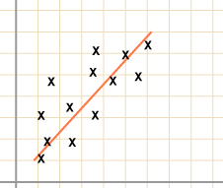
GCSE 1-9 Science Key Things to Remember: Lines of Best Fit
A line of best fit (or "trend" line) is a straight line that best represents the data on a scatter plot. This line may pass through some of the points, none of the points, or all of the points.

Slide 11
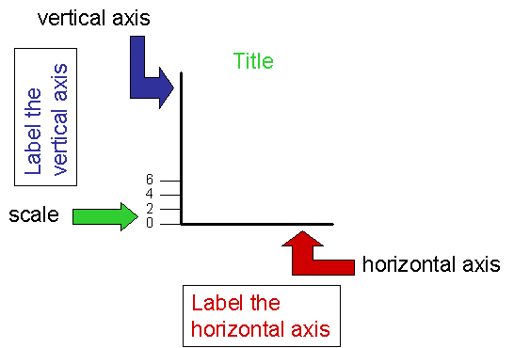
GCSE 1-9 Science Key Things to Remember: Scale on a Graph
The scale is what you mark on the axes. It's the relation between the units you're using, and their representation on the graph i.e., the distance between marks.
Remember that your scale must go up in equal amounts

Slide 12
GCSE 1-9 Science Key Things to Remember: Accuracy and Precision
Accurate results are results that are close to the true value. In science we rarely know what the true value is so this can be quite a difficult concept to master.
Precision is not really about decimal places – instead if refers to the closeness of two or more measurements to each other. Obviously, if you are recording results to more decimal places (sig figs) then they could be more precise than recording to one e.g. 12.5 and 12.6 are more precise results than 12 and 12. But, 13 and 17 are more precise than 13.5 and 20.5.

