Slide 1
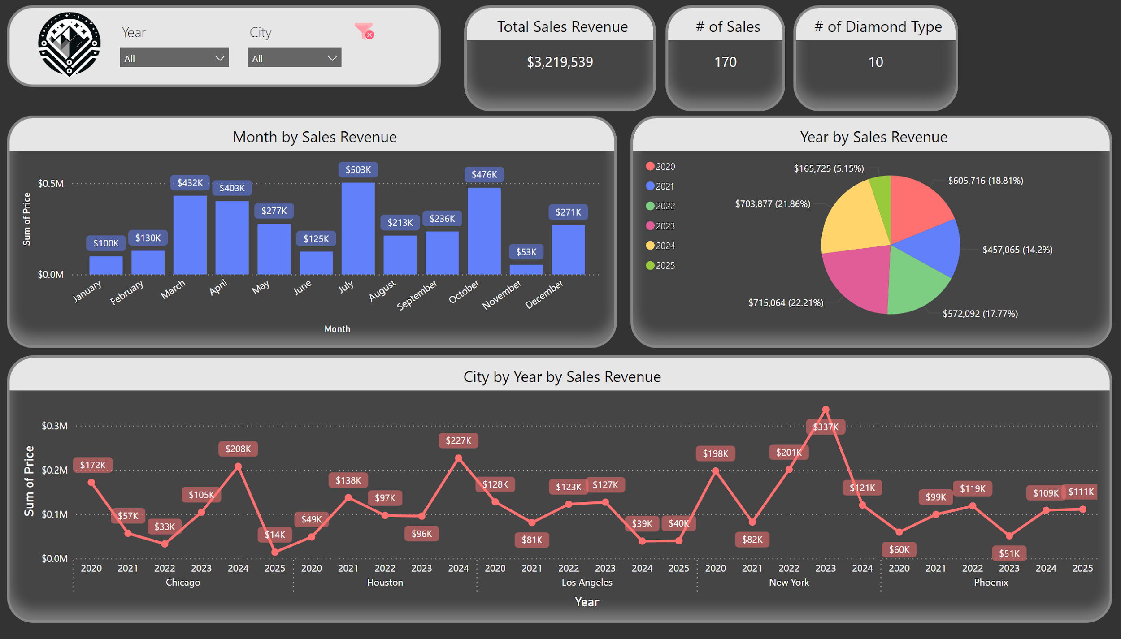
Notes:
textbox
No alt text provided
image
No alt text provided
Month by Sales Revenue
No alt text provided
slicer
No alt text provided
Year by Sales Revenue
No alt text provided
Total Sales Revenue
No alt text provided
# of Sales
No alt text provided
# of Diamond Type
No alt text provided
City by Year by Sales Revenue
No alt text provided
slicer
No alt text provided
image
No alt text provided

Slide 2
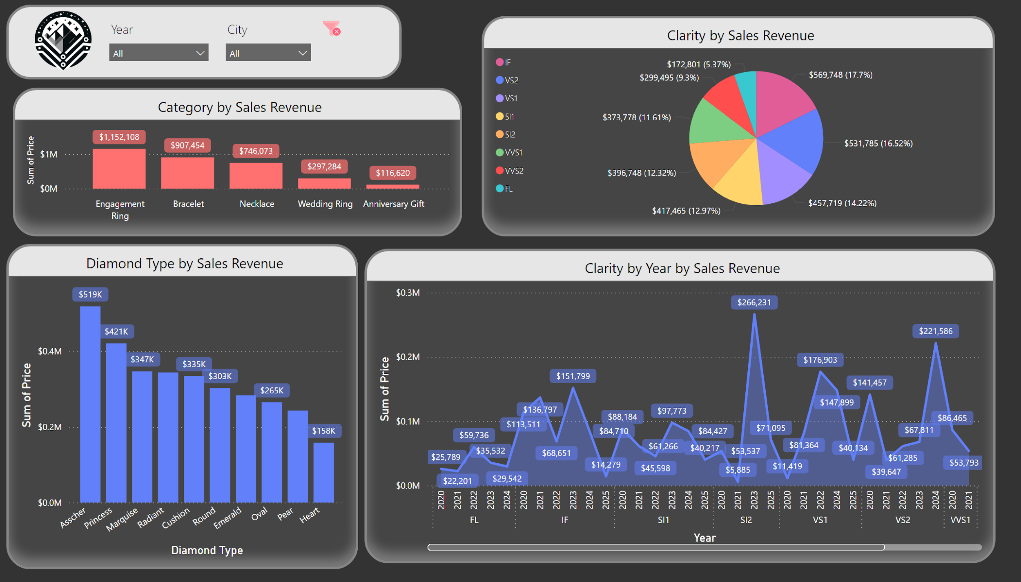
Notes:
textbox
No alt text provided
Category by Sales Revenue
No alt text provided
Clarity by Year by Sales Revenue
No alt text provided
Clarity by Sales Revenue
No alt text provided
Diamond Type by Sales Revenue
No alt text provided
slicer
No alt text provided
slicer
No alt text provided
image
No alt text provided
image
No alt text provided

Slide 3
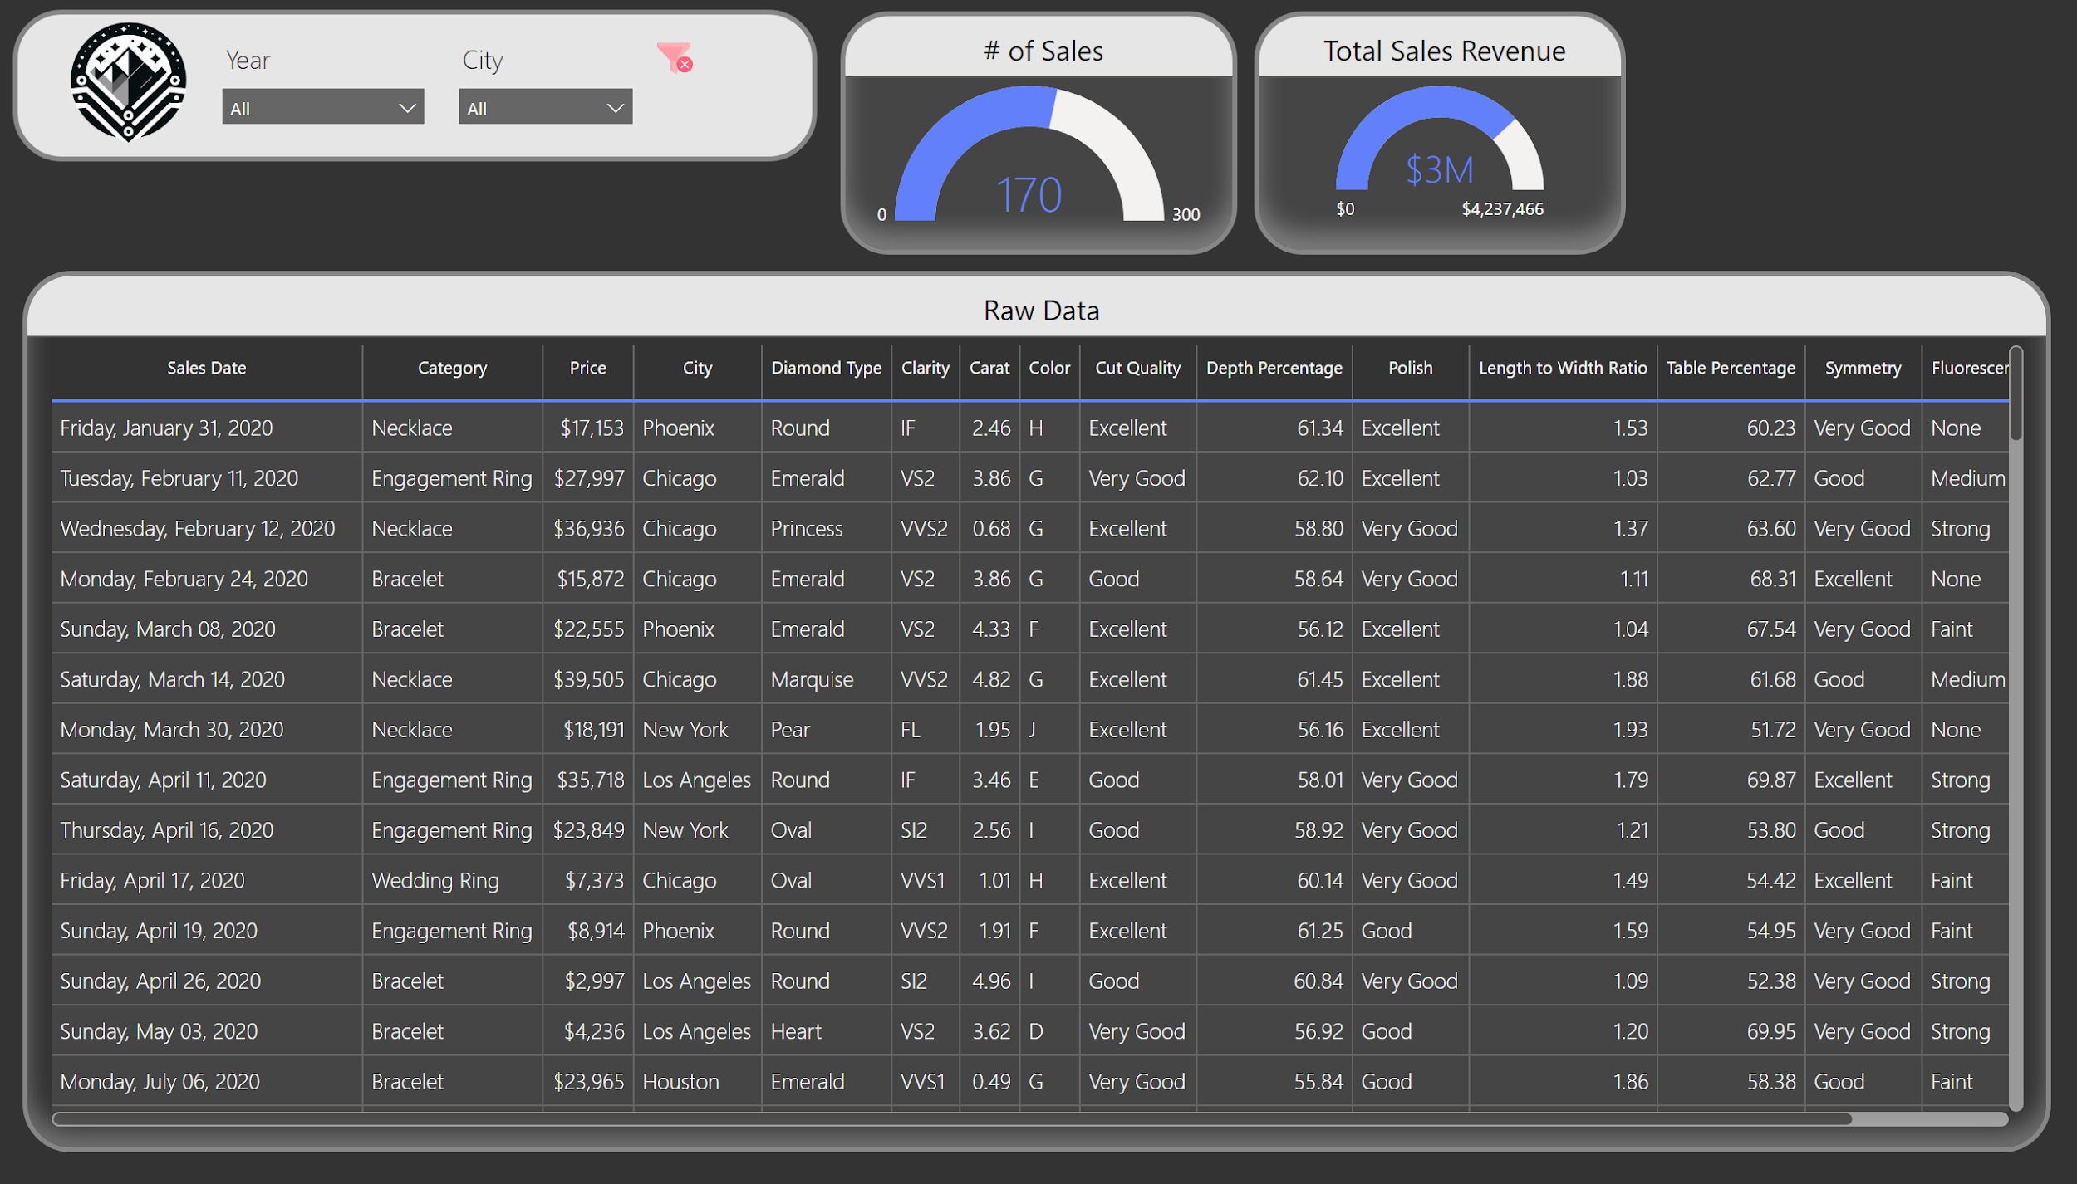
Notes:
textbox
No alt text provided
Total Sales Revenue
No alt text provided
# of Sales
No alt text provided
Raw Data
No alt text provided
slicer
No alt text provided
slicer
No alt text provided
image
No alt text provided
image
No alt text provided

