Slide 1
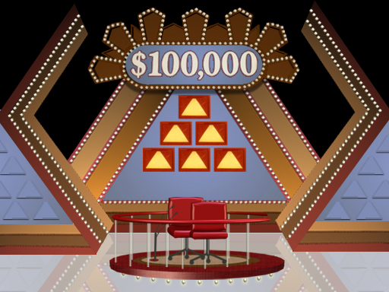

Slide 2
200 POINTS
100 POINTS 100 POINTS
Put Phrase Here
50 POINTS 50 POINTS 50 POINTS

Slide 3
“TALK A MILE A MINUTE”
BIG CONCEPT
Examples or words that are related to the big concept.

Slide 4
“TALK A MILE A MINUTE”
Properties
Distributive
Associative
Commutative
Reflexive
Additive Inverse
Multiplicative Identity

