Slide 1
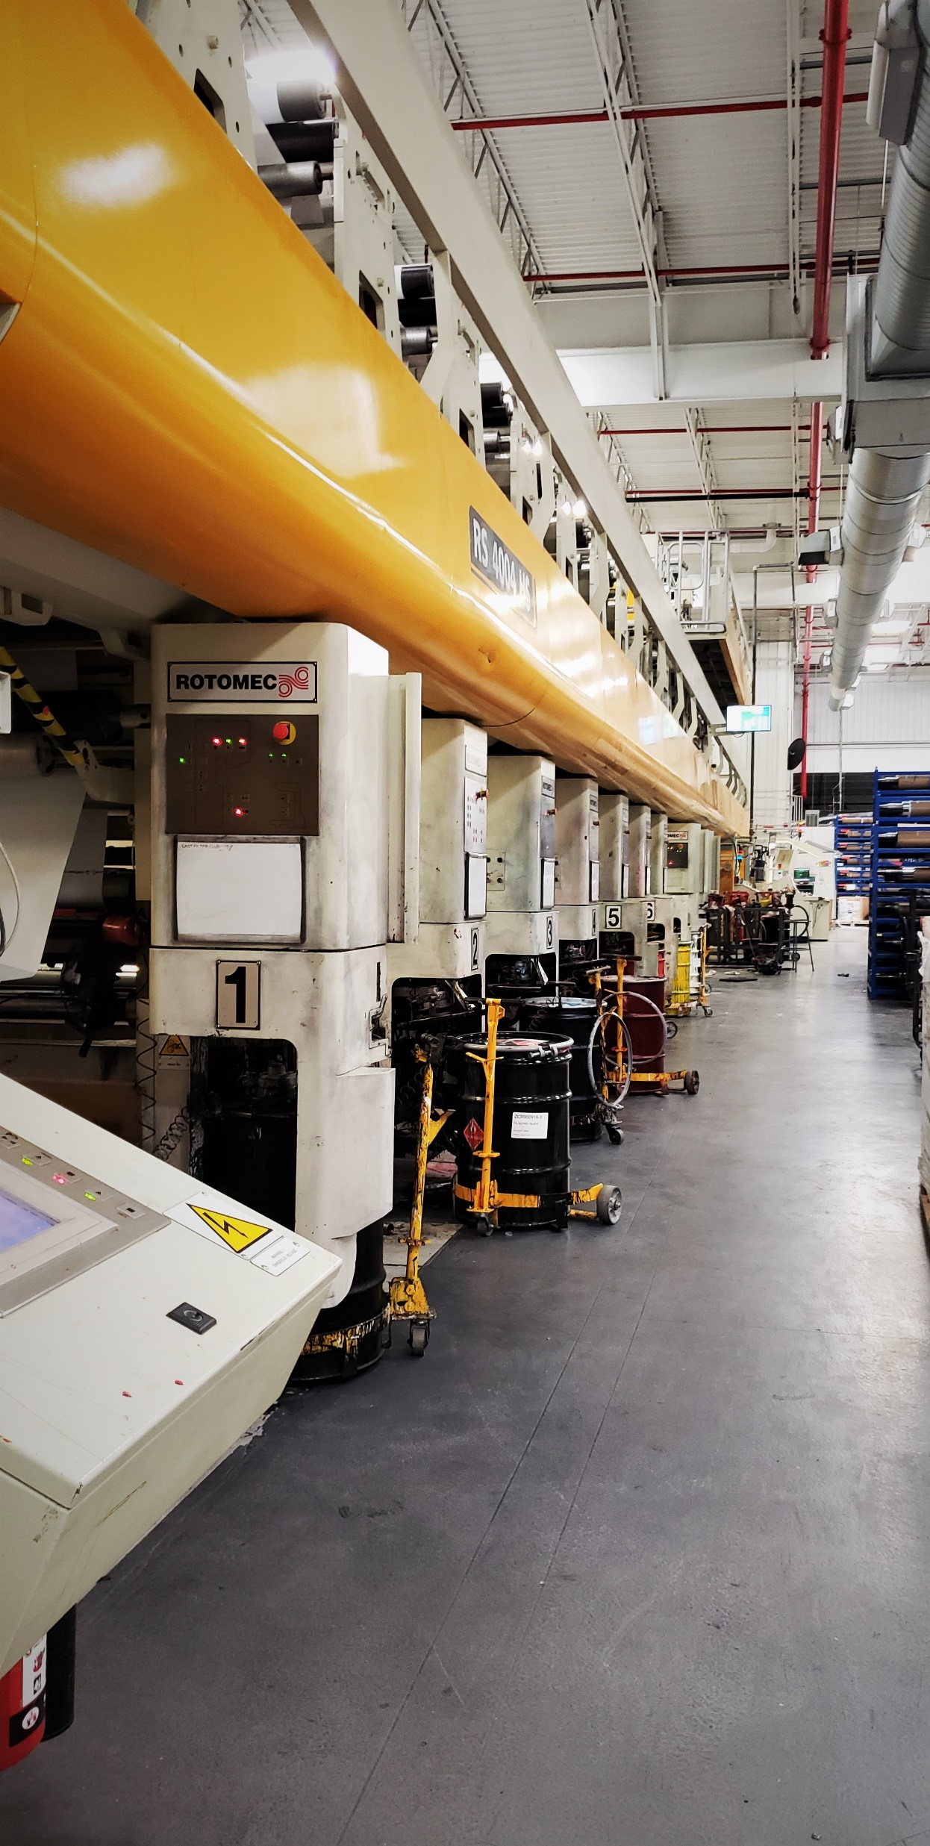
Train the Trainer
Part One
Adult Learning and Learning Styles

Slide 2

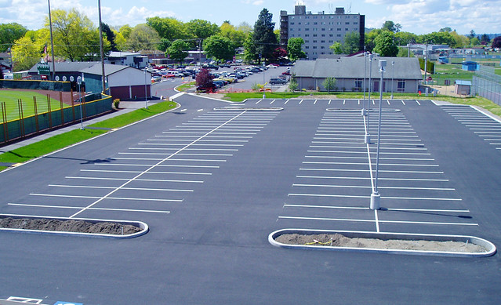
Training Session Ground Rules
Hour long sessions
Snacks and drinks are fine, as long as the noise level is reasonable
Questions are GREAT! Odds are, if you’re thinking it, someone else is too.
Judgement free zone!
Parking Lot

Slide 3
Building a Relationship
Write the following information on your note card:
  Your name
  How long you have worked for the company
  Your current position
  Your level of training experience (here or elsewhere)
  What do you like to do for fun when you’re not at work?

Slide 4
Key Learning Points
Recognize and understand the ideas related to adult learning theories
Reflect on and discuss your own “adult learning experiences”
Differentiate between adult learners and primary students
Identify various learning styles and determine one’s own preferred learning style

Slide 5
Reflect on Personal Training Experiences
Complete Activity 1 in your binder

Slide 6
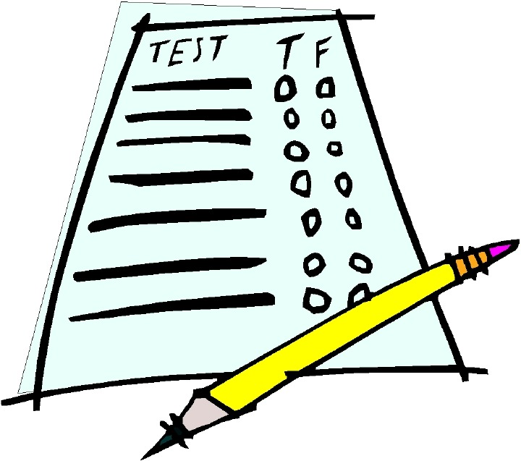
Adult Learning
Test your knowledge
Complete Activity 2 in your
workbook by yourself
How many did you get right?

Slide 7
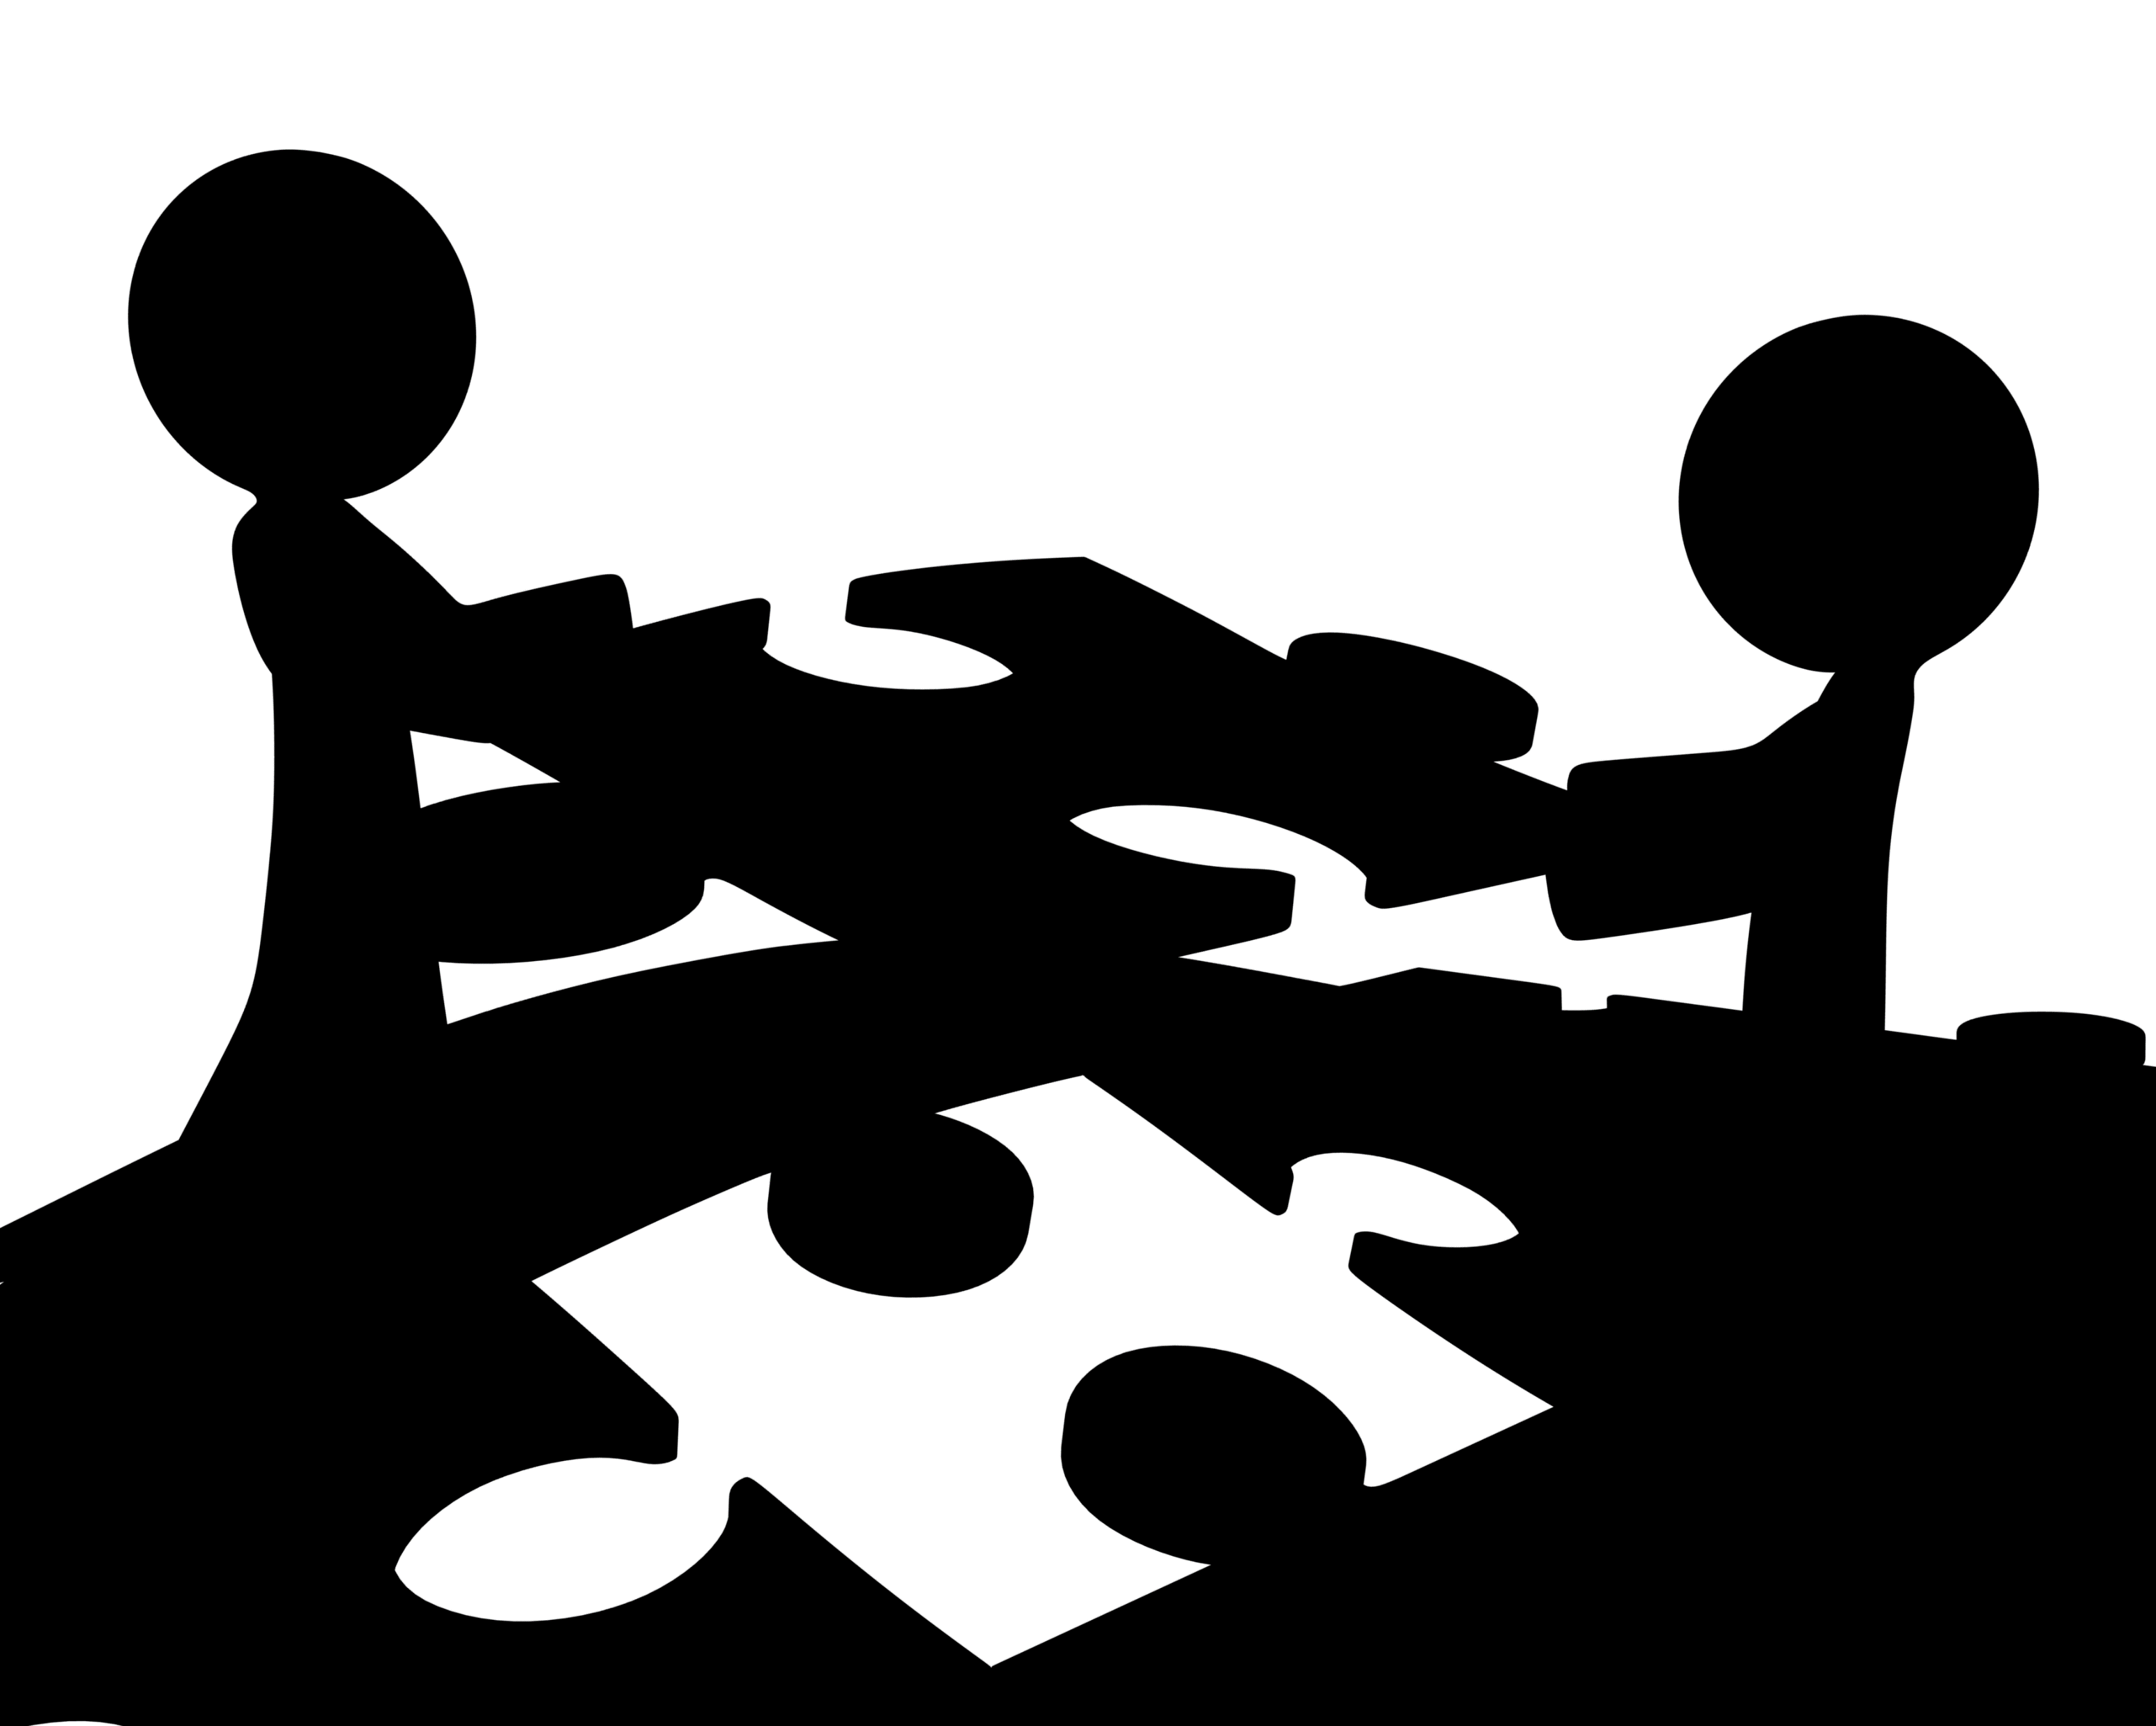
Adult Learning – 5 Principles
Personal Benefit
  Adult learners must be able to see the personal benefit of what they are learning. They are motivated to learn if the learning:
  Solves or avoids a problem for them
  Provides an opportunity or increased status
  Leads to professionalism or personal growth
  Learning is driven by motivation; the more motivated they are, the more they learn

Slide 8

Adult Learning – 5 Principles
2) Experience
Adult learners come to each learning event with a unique background of knowledge and experience. They are motivated to learn if the learning:
  Involves them in sharing what they know
  Builds on what they know
  Validates their expertise
  Side Note: Demonstrate respect for differing beliefs, religion, value systems, and lifestyles

Slide 9

Adult Learning – 5 Principles
3) Self Direction
Adult learners are self directed and must have some control over what they are learning. They are motivated to learn if they can:
Take charge of their learning and make decisions about the content and process
Contribute to the learning of their co-workers
Have some degree of independence in the learning process
Avoid merely “transmitting knowledge”
(i.e. talking AT them vs talking WITH them)
Engage and involve the learner!

Slide 10
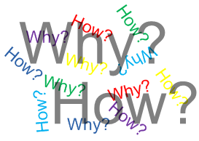

Adult Learning – 5 Principles
4) Application and Action
Adult learners are busy and practical. They learn best when:
There is immediate application for the learning
They participate actively in the learning process
They can practice new skills or test new knowledge before leaving a learning session
Tell them WHY a task is performed the way it is. Explain the value of the process and why it is important.

Slide 11
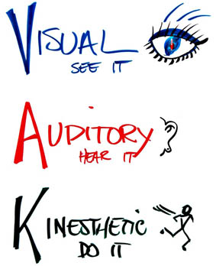
Adult Learning – 5 Principles
5)Learning Styles
Adult learners approach learning in a variety of ways, from hands-on and moving, to using their eyes, ears, and/or logic to anchor new skills and knowledge. They learn best when:
                Their learning taps into a mix of learning styles that fit their preference
                Multiple means are used to represent the material being learned
Find out what their learning style is before hand to help fast track the training by providing the type of learning they work best with.

Slide 12
Adult Learning Principles Summary
Adult learners bring their own experiences to the training that must be validated
Adult learners like to be involved in determining the direction of the training, and need to be able to apply what they learned shortly after the training
Adult learners need to know WHY something is done a certain way, and what’s in it for them (WIFM) for doing it that way
Adults have different styles of learning that aide in information understanding and retention

Slide 13
Learning/Sensory Styles
Visual
Aural
Reading/Writing
Kinesthetic
VARK

Slide 14
VARK Questionnaire
Take the VARK learning style questionnaire in your handout packet and score your results.
We will go over what each of the learning styles are after the questionnaires have been completed.

Slide 15
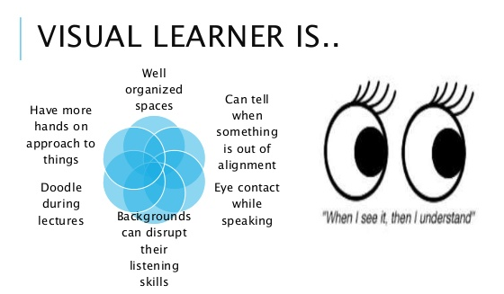
Visual Learners
Visual learners are most able to retain information when they see it, whether that’s written down, on a chart, in a video, or via a diagram. They find it much easier to remember images they have seen than recall something they’ve been told. Visual learners make up around 65% of the population.
Signs this is you:
- Do you find yourself remembering information better if you physically see it?
- Are you aware of aesthetics around you?
- Do you often visualize information to help you learn?
Can you easily recall faces, photographs or paintings when asked?
Are you easily distracted by background noise?
Visual Learners like:
Presentations with pictures and colors
Videos on how to do a certain task
Instructions with pictures and diagrams
Organized training materials and workspace
To see the task being performed before doing it
Notes:
Amcor example: rather than pointing at a part of the machine and describing how to set it up. Physically show the visual learner how while talking them through it.

Slide 16
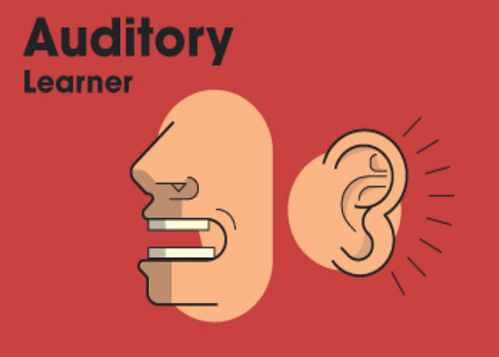
Auditory Learners
Auditory learners learn by actively hearing and listening. They prefer to listen to instructions rather than read them. Auditory learners make up around 30% of the population.
Signs this is you:
- Do you prefer to listen and discuss rather than read or watch?
Do you find yourself chatting when you lose interest in something being taught?
Do you sometimes read instructions out loud to help comprehend them?
Do you like to talk through problems?
Are you good at explaining things?
Auditory Learners like:
Trainers who present information orally (talking)
To have the chance to talk through complex topics
To be around other people (to have a chance to talk)
To repeat things back to the trainer

Slide 17

Read/Write Learners
Read/Write learners learn by reading and writing. They often take excellent notes and excel in classroom style lectures.
Signs this is you:
You take a lot of notes, often word-for-word
You like to make lists
You tend to organize information from graphs and charts into word format
You enjoy reading, and work best in a quiet environment
Read/Write Learners like:
To have written step-by-step directions
A notebook to carry with them to take notes in
Time to rewrite notes and organize them in a way that makes sense to them
Slow talking by the trainer

Slide 18
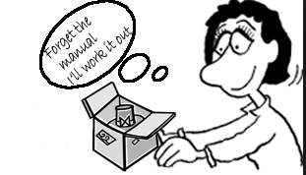
Kinesthetic Learners
Kinesthetic learners learn by moving, doing, and touching. They are explorers at heart and like to learn through active participation in what they are learning. Kinesthetic learners make up around 5% of the population.
Signs this is you:
When you get new furniture (or toys) you find yourself skipping the directions in the box and going right to putting it together
You have a hard time sitting still for too long
You tend to talk with your hands
Kinesthetic Learners like:
To be able to learn something by DOING it
Something to keep their hands busy during long talks
To skip the written instructions and have something explained to them as they are doing it

Slide 19
Summary of VARK Learning Styles
Activity 3
Get with a partner

Slide 20
Reflection on today’s class
On a note card, write down 2 things you learned today or found interesting.
For next time:
  Prepare 2 quiz questions about today’s lesson and be prepared to quiz your peers

