Slide 1
1100’s Guide To Chairman’s
Team 1100, January 2017

Slide 2
1100’s Award History
Won Chairman’s twice
2013 WPI Regional
2014 Rhode Island District event
Notes:
JASON

Slide 3
The Presenters
Tess Herdman: Non-Engineering Captain
Taylor Murphy and Tessa DesMarais: Awards Subteam Captains
Samara Patterson: Drive Team Operator
Jason DesMarais: Alumni Mentor
Notes:
Jason

Slide 4
Part One:
Building Your Chairman’s Resume

Slide 5
What is Chairman’s?
Most prestigious award given to teams that embody FIRST ideals
to inspire young people to be science and technology leaders, by engaging them in exciting Mentor-based programs that build science, engineering, and technology skills, that inspire innovation, and that foster well-rounded life capabilities including self-confidence, communication, and leadership.
Notes:
TAYLOR

Slide 6
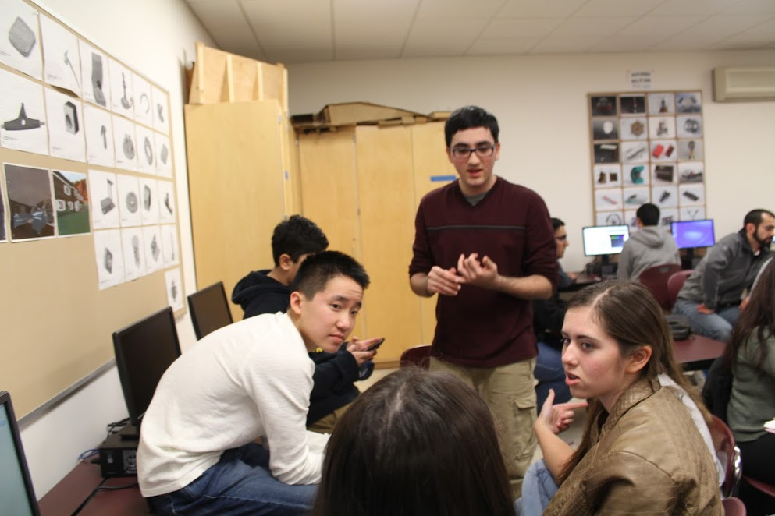
Where to Start
Find motivated members, form a subteam
Idea students, who will come up with ways to better your outreach, work hard to find new ways to spread FIRST
Passionate leadership
Promote wider outreach and keep people going
Don’t be afraid to reach out to new sponsors or groups!
Notes:
TAYLOR

Slide 7
The Pyramid
Alumni and Special Qualities
Team Dynamics and Sponsors
Outreach Within FIRST
Growth in Community Outreach (OUTSIDE FIRST)
Notes:
TESS

Slide 8
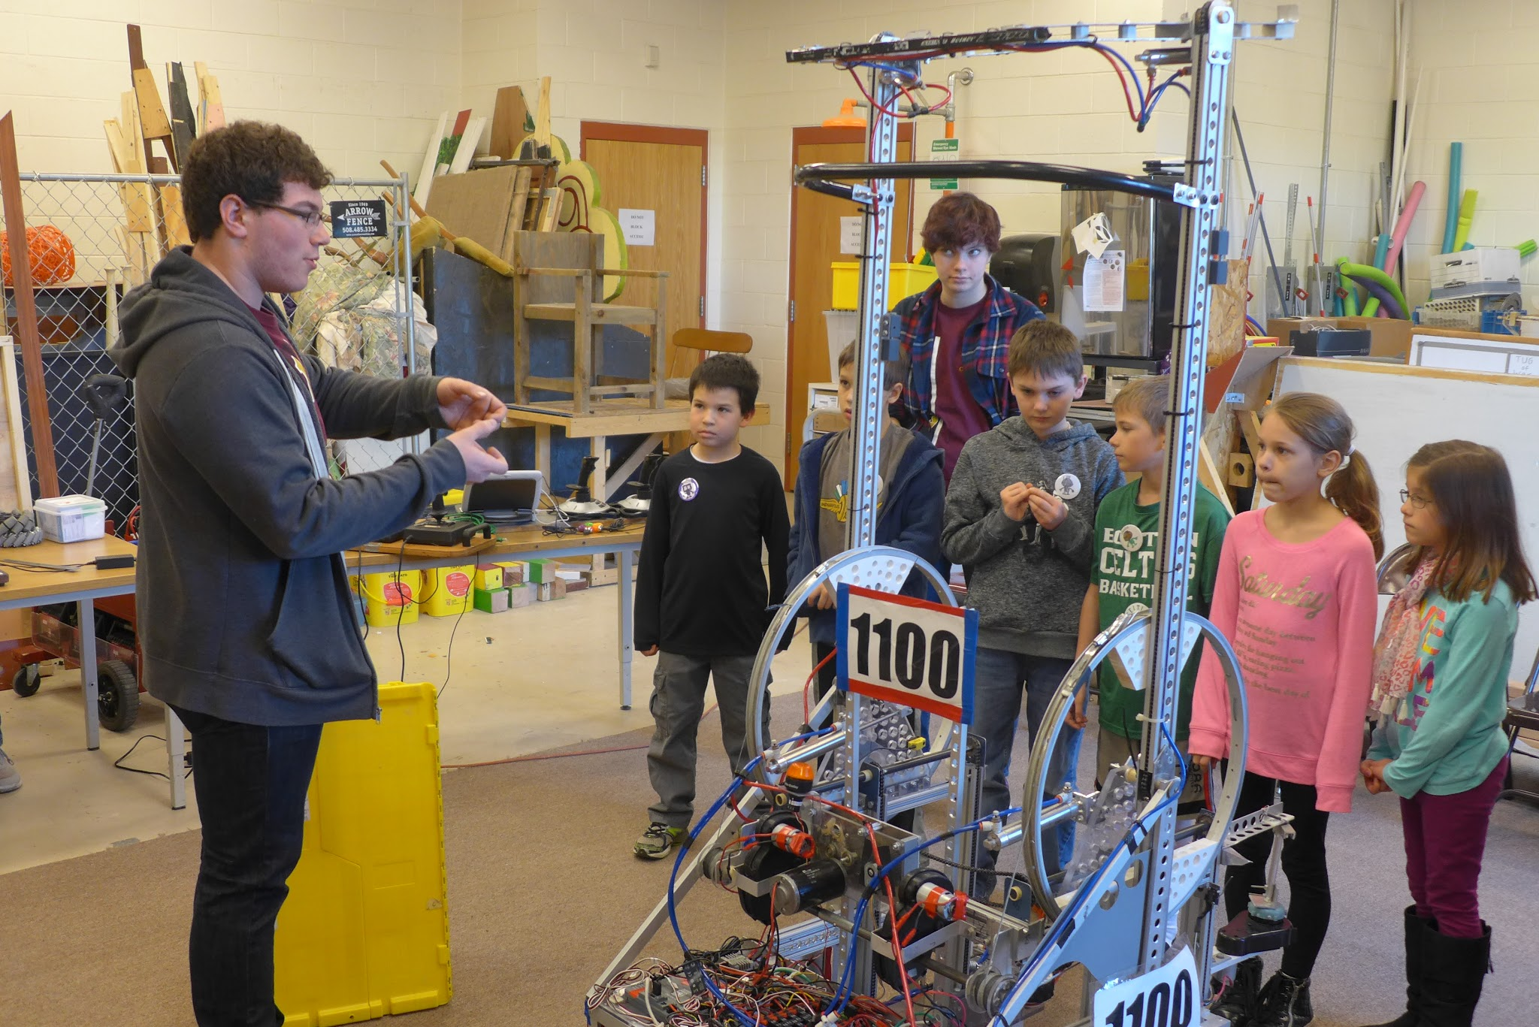
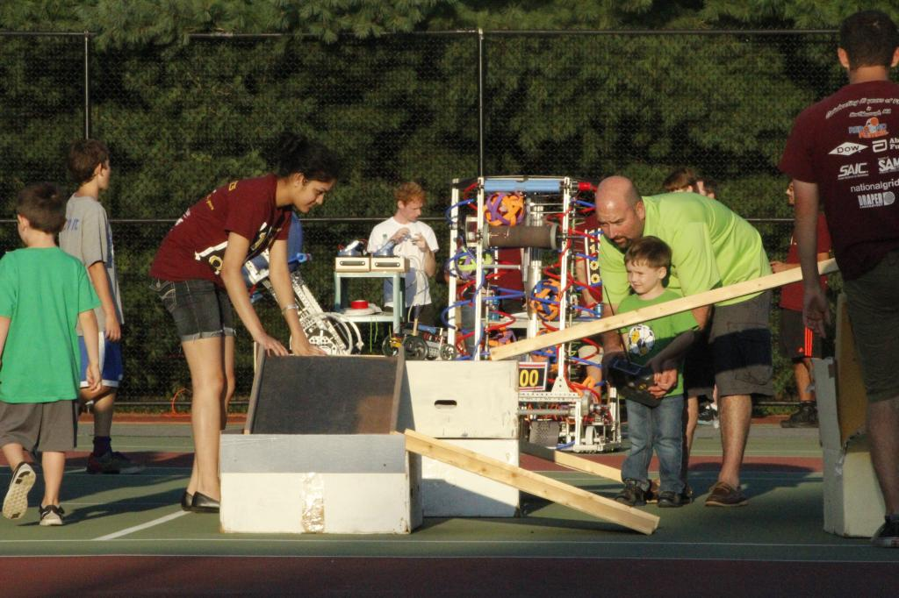
The Base of the Pyramid: Community Outreach
Find unique ways to spread STEM to the community
Ex. Build Your Own Robot Day
Ex. Community fairs (Applefest, Summer Nights)
Notes:
Summer Nights
TESS

Slide 9
The Base of the Pyramid: Community Outreach
Libraries | Good place in the community to hold small events
Boy and Girl Scouts | Demos -- kids love watching robots! Tell them how they can get involved when they’re older!
Elementary/middle schools
Sponsors | Keep the ones you have up to date, and expand to new ones through events and connections
FLL/Jr. FLL | Team members can be mentors, team can host events (ex: Qualifier!)
School events (football games, carnivals, activity fairs) | Get involved with some games! We often drive our competition bot, use our t-shirt cannon bot, and sometimes let spectators drive miniature bots
Notes:
TESS

Slide 10
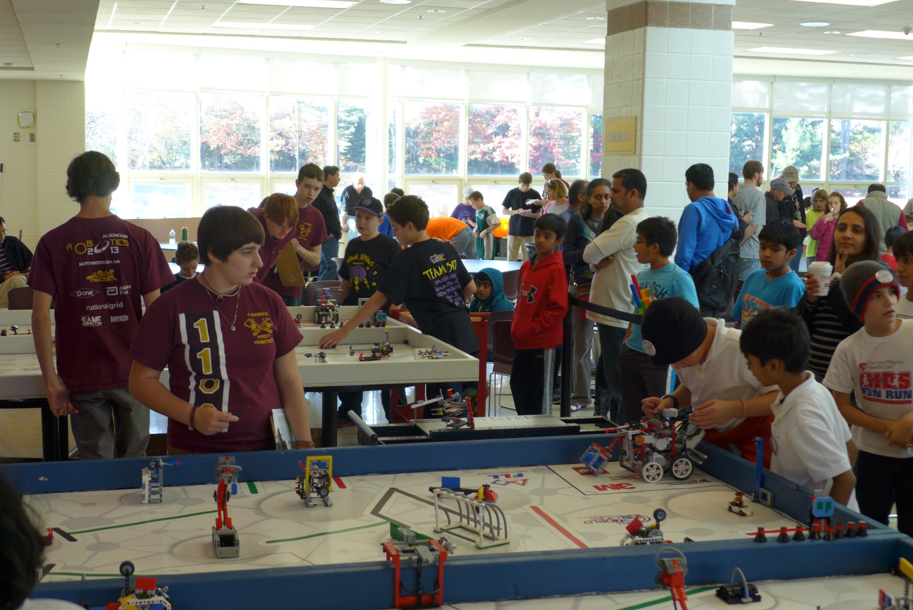
The Next Tier: Within FIRST
FLL
Host qualifiers, support/start teams, new events, mentor them, etc
Ex: T-Hawk Test Drive and Northborough Qualifier
FRC
Financial support, start teams, mentors and alumni, facility usage, etc
Ex: Presenting at local kickoff events
Notes:
SAMARA

Slide 11
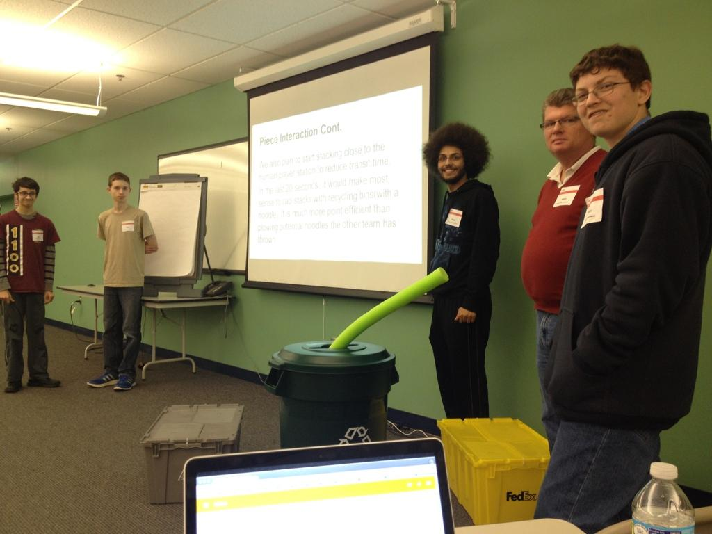
Almost to the Top: Team Dynamics And Sponsors
Your team is a family
Form strong bonds as friend groups mingle
Team Organization/Student Leadership
Sponsors support your team
Thank them, formally and/or by inviting them to events and demos
Ex. DOW demo
Always be on the lookout for new sponsors to talk to, explain what your team is about, and bring into FIRST
Notes:
SAMARA
have defined subteam grops fro examples. having student leaders thruout your team is equally as important as having your student team captain
sponsors range from families to small businesses to large companies, keep them in the loop , look in your town, and parents companis etc...

Slide 12
The Top: Special Qualities and Alumni
Determine what makes your team Unique
Ex: 1100 has a large amount of girls
Don’t have a quirk?
Alumni
Keep contact to ask for questions and advice
Can be pathways to more sponsors, mentors, and outreach for your team
Notes:
SAMARA - ASL stuffs Weekly team parties or events, your minorities, your special work, etc
the top of your pyramid is what will put your team over the top
chairmans ppl looooooove hearing about how alumni boost your numbers, those who continue on to engineering careers

Slide 13
Part Two: Selling It

Slide 14
The Basics
Applying for Chairman’s
Only talk about your good, unique traits
Try to show your growth
It’s about what you do with the resources you have
Presenting Chairman’s
Prove your team qualifies and has grown enough to win
You promote the message of FIRST
Be charismatic, articulate, and have evidence
Notes:
TESSA

Slide 15
“Pre-Chairman’s” Season: Planning
Rules will be part of the admin/game manual
Rule changes from previous years
Definitions (“assisting” vs. “mentoring” a team)
Video specifications
Set a team calendar!
Think REALISTICALLY about what you can accomplish while you’re working on the essay
Notes:
TAYLOR

Slide 16
“Pre-Chairman’s” Season: Photos
ALWAYS BE TAKING PICTURES!
ALWAYS BE WEARING YOUR TEAM SHIRTS!
Events
Children working with members
Show your influence in the community
Everyday meetings
Team and mentors interacting
Creative process
Competitions = team spirit! Show your passion!
Notes:
TAYLOR

Slide 17
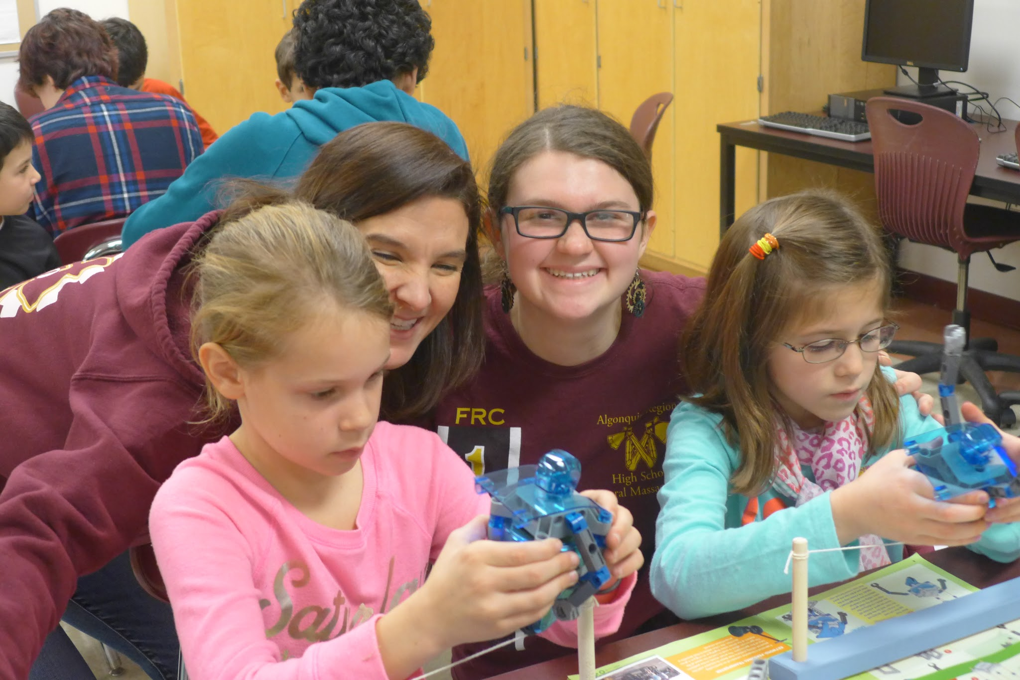
Sample Pictures - Community Outreach
Notes:
TESS

Slide 18
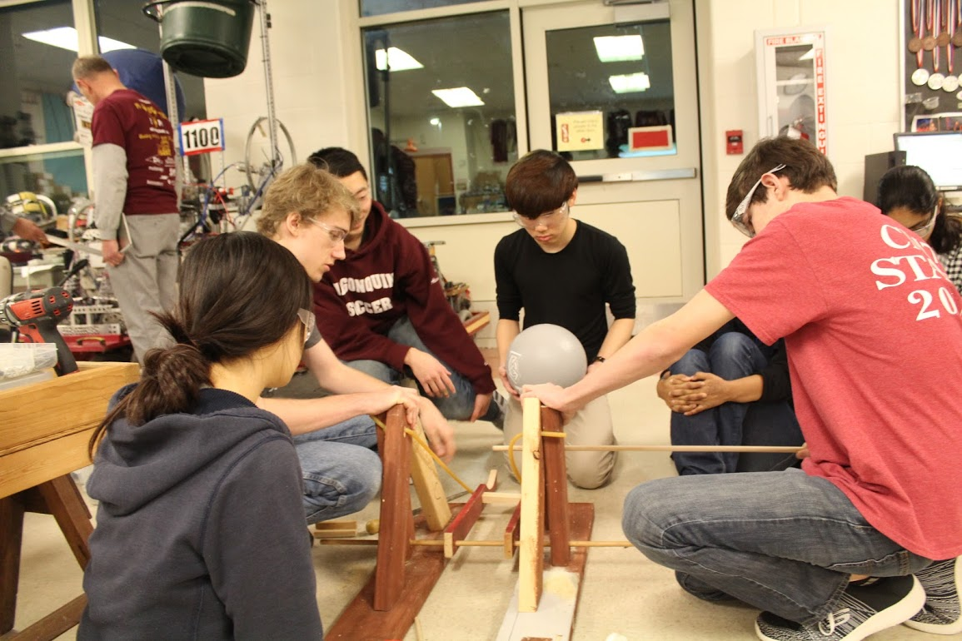
Sample Pictures - Build Season Process
Notes:
TESS

Slide 19
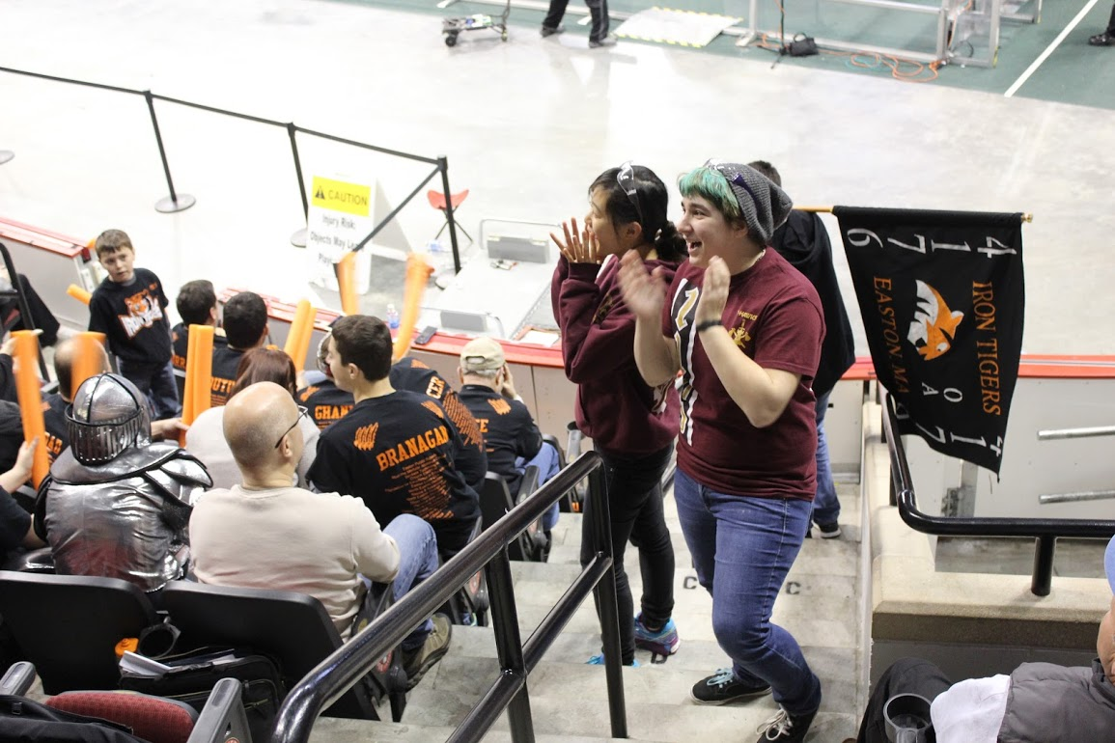
Sample Pictures - Events
Notes:
SAMARA
our team members interacting with other teams showing team spirit and what makes us a unit

Slide 20
The Essay
Organization
Outline, like any normal essay
Get your facts together
KEEP A TEAM HISTORY
Theme
Great for flow, but emphasis is on content
Past example: 1100 - “Build it better”, 987 - “It’s not enough”
Readability
Judges read many essays, make sure it makes sense
Notes:
SAMARA
Team history very important -trust us, it will be so much easier in your future
theme is not incredibly important

Slide 21
The Essay cont.
Alumni and Team Special Qualities
Team Dynamics and Sponsors
Outreach Within FIRST
Growth in Community Outreach (OUTSIDE FIRST)
Notes:
TESSA
roughly one third

Slide 22
Executive Summary
Answering questions about your team
Keep within word limit: 500 words
STAY FOCUSED -- Answer the question
Choose what you talk about carefully
Keep on message
Notes:
TAYLOR

Slide 23
The Video
During the Presentation: Optional
Pros
Cons
Convey more messages concisely, decrease amount to speak
Intrigue judges
More time to work on it
Won’t see unless in top 3
Can take up a lot of time
Need good equipment, good video
Notes:
TESSA

Slide 24
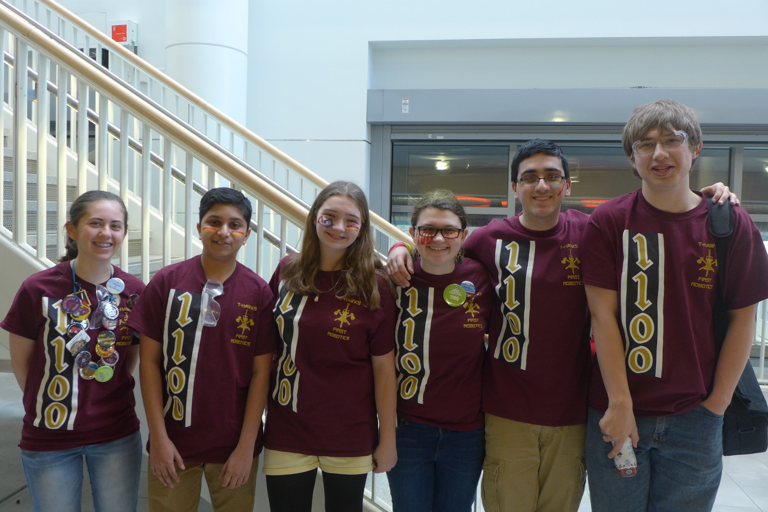
The Presentation at the Competition
Practice how to answer questions you don’t know answers to!
Always be prepared for personal questions
Try to bring up what makes your team special
PRACTICE PRACTICE PRACTICE
Choose your presenters wisely, have alternates
Team spirit and energy
Notes:
TESSA

Slide 25
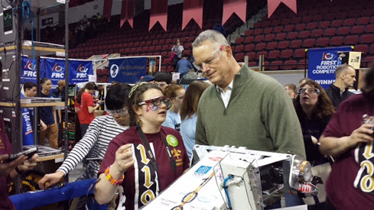
Judge-Talking
Know. Your. Stats.
Like an interview-- introductions are important!
Training members
everyone comes in and out of pit ~ everyone should know
“go to” people
the art of redirection
You never know who you might meet in the pits!
(Governor of MA Charlie Baker)
Notes:
TESS

Slide 26
Thank you to team photographers, helpers, and presenters!
Above all, Chairman’s is a team effort.
Tess Herdman
Alex Chen
Andrew Gao
Betsy Rosenbloom
Patty Gigliotti
Avdait Dhamdhere
Numaan Dogar

