Slide 1



California Health in All Policies HiAP
Executive Order S-04-10 – Enacted February 23, 2010
Notes:
Title Page

Slide 2

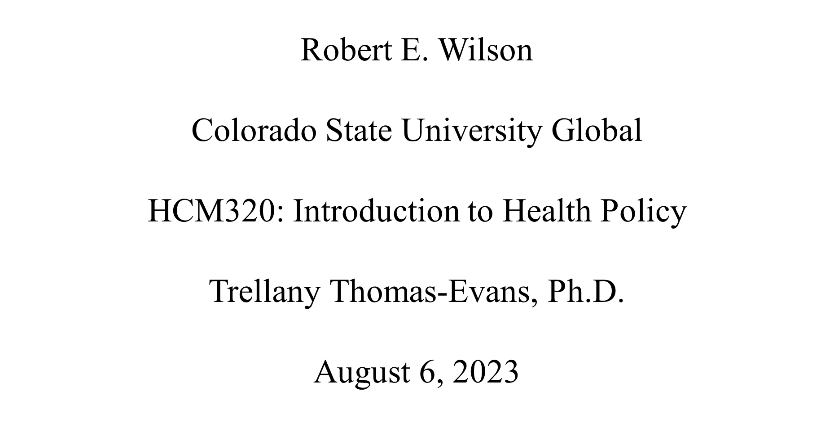
Notes:
APA Format Title Page

Slide 3

California Health in All Policies [HiAP] Executive Order
S-04-10
Issued by Governor Schwarzenegger February 23, 2010
Established California HiAP Task Force
First in the Nation to do so
Convenes over 20 State agencies and departments as well as public and private stakeholders
(Exec. Order No. S-04-10, 2010)
Notes:
On February 23, 2010, California Governor Arnold Schwarzenegger issued Executive Order S-04-10 which established the creation of the California Health in All Policies Task Force [HiAP]. This would make California the first state in the Nation to adopt such a health policy, making it a leader in the future of public health within the United States. The California HiAP Task Force convenes over 20 state government departments and agencies to advance health, equity, and environmental sustainability (Exec. Order No. S-04-10, 2010).

Slide 4

What is HiAP?
a policy framework and approach
Emphasizes significance of cross-sector cooperation
Shifts focus from biology to behavioral and lifestyle factors.
integrates health, well-being, and equity across policy development, implementation, and assessment
differs from related approaches by deliberate cross-sector collaboration with public and private decision-makers and community-based stakeholders
(Pepin et al., 2017)
Notes:
Health in All Policies is a policy framework and approach that has been gaining wider acceptance since the movement began to take shape during the 70’s and 80’s in European countries. HiAP emphasizes the significance of cross-sector cooperation and redirects attention from the biological underpinnings of health results towards a more comprehensive recognition of the influence of behavioral and lifestyle factors as well as environmental conditions. HiAP integrates health, well-being, and equity considerations across policy development, implementation, and assessment. HiAP differs from related approaches by its deliberate cross-sector collaboration involving public and private decision-makers as well as other community-based stakeholders (Pepin et al., 2017). The infographic shown on slide five from the World Health Organization [WHO] (n.d.), shows us an example of HiAP at work using air pollution exposure for their example.

Slide 5
HiAP
flow chart
(World Health Organization [WHO], n.d.)
Notes:
As we can see from this infographic, HiAP requires different sectors working together such as health, transport, housing, work, nutrition, and water and sanitation. The example given here from the World Health Organization [WHO] (n.d.), we look at air pollution exposure. One in eight deaths can be linked to air pollution exposure. In order to tackle the air polution issue through HiAP, collaboration is needed. Between clean energy, housing, industry, transport, urban planning, waste management, local and regional authorities, and the health ministry – each sector can address ways within their industry to address reducing air pollution exposure and therefore increase health outcomes through environmental and behavioral means as opposed to medically treating chronic respiratory issues caused from air pollution exposure, a kind of preventative measure (WHO, n.d.).

Slide 6
Why HiAP?
facing critical problems-climate change, water shortages, fiscal challenges, aging population, and increasing health inequities
facing unprecedented levels of chronic disease
chronic disease = 75% of all deaths in California + 75% of all U.S. health care expenditures
in 2006, Obesity and overweight cost California an estimated $21 billion
looking for innovative solutions
healthcare contributes small 10-15% to health outcomes
health determinates contribute greater to health outcomes
promising results in HiAP in other western countries
(“Health”, 2010)
Notes:
According to the California Health in All Policies Task Force Report to the Strategic Growth Council Executive Summary (2010), California was facing critical problems in areas such as climate change, water shortages, fiscal challenges, an aging population, and increasing health inequities that needed urgent attention and thoughtful consideration of which would shape the future of Californians for generations to come. Additionally, the task force notes that,
California and the Nation, [where] facing unprecedent[ed] level[s] of chronic disease, which, [at the time], account[ed] for over 75 percent of all deaths in California and 75 percent of all U.S. health care expenditures. Obesity and overweight, which increase chronic disease risk and contribute to lost productivity, cost California an estimated $21 billion in 2006 (“Health”, background section).
California was looking for a better way, an innovative way, to help address these issues.
They recognized that while medical care is important, it only contributes a small portion (about 10 - 15 percent) to overall health and life expectancy. Social determinants of health have a greater impact on how long and how well we live than medical care alone and the environmental impact on health is both directly and indirectly related. The World Health Organization, the European Union, South Australia, Finland, and other Western nations were all exploring ways to implement HiAP with much success (“Health”, 2010).

Slide 7
Why HiAP? (cont.)
HiAP could address most every concern and match the goals of the state.
sustainable communities playing a crucial role in health aligns with the goals of the Strategic Growth Council (SGC) of California
local produce consumption enhances health and preserves agricultural lands
policies supporting active transportation promote physical activity and reduce emissions
focusing on infill development curbs sprawl, lowers greenhouse gases, and encourages health-friendly housing
good health drives economic sustainability, workforce productivity, and reduces medical care costs
addressing the social determinants of health will greatly impact well-being
adopting a HiAP approach, public health agencies can collaborate with various sectors for a comprehensive health improvement
(California HiAP Task Force, n.d.)
Notes:
By adopting a HiAP policy, they could tackle most every need for Californians. With health playing a crucial role in sustainable communities, it aligns with the objectives of the Strategic Growth Council (SGC) in California. Fostering local produce consumption enhances health and preserves agricultural lands. Introducing policies supporting active transportation promote physical activity and reduce emissions. Focusing on infill development curbs sprawl, lowers greenhouse gases, and encourages health-friendly housing. Good health drives economic sustainability, workforce productivity, and reduces medical care costs, leaving more funding for education and green energy investments. Addressing the social determinants of health, which encompasses environments and resources, will greatly impact well-being, surpassing medical care's influence. Disadvantaged communities face worse health due to limited resources, necessitating an environment-focused behavior change. Adopting a HiAP approach, the public health agencies can collaborate with various sectors, including housing, transportation, and education, for a comprehensive health improvement (California HiAP Task Force, n.d.).

Slide 8
HiAP and Health Disparities
HiAP recognizes health disparities contribute inordinately to health outcomes
HiAP brings together vital public, private, and community organizations
HiAP can utilize cross-sectional corroboration in planning and policy making, focusing on how health fits into all agencies priorities diminishing health disparities at all levels
(CHCS, 2018)
Notes:
The main ideology behind HiAP initiatives is the recognition and fact that health disparities contribute inordinately to health and health outcomes. By bringing together vital public, private, and community agencies and organizations whose focus is specifically and directly related to a potential health disparity, the HiAP can utilize this cross-sectional corroboration in planning, policy making, and focus upon how to integrate maximum health outcomes within their respective domains. Looking at the table from the Center for Healthcare Strategies [CHCS] report Promoting Better Health Beyond Health Care - Exhibit 1 (2018b), we can see how these intragovernmental departments and agencies, along with other stakeholders with leverage in addressing disparities, can effectively direct the health outcome within HiAP framework (see Exhibit 1, on slide 9).

Slide 9
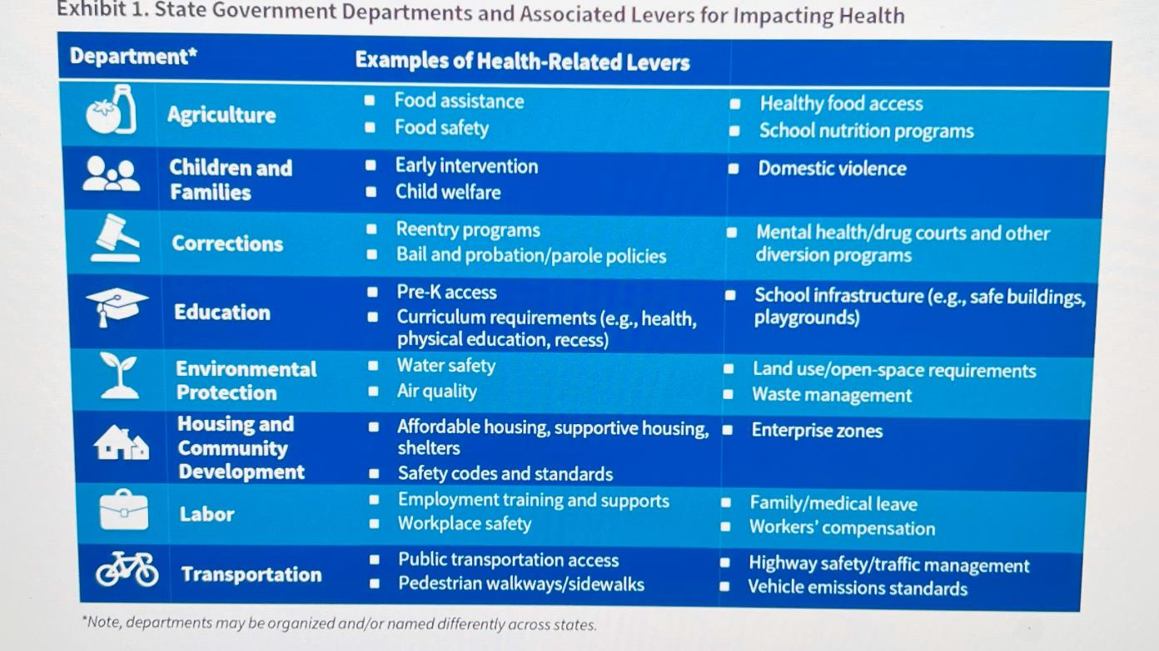
(CHCS, 2018)
Notes:
As we can see, every defined Health Disparity is addressed and taken into consideration in one way or another. This table also shows how intertwined all facets have become.

Slide 10
The Impact of HiAP
Upon California's lead, HiAP has spread to numerous states and continues to be adopted in new states every year
12 action plans introduced
Key policies in healthy food purchasing, greater access to green spaces, and active transportation have seen positive changes
healthy food, active transportation, violence reduction and resilient communities
enhanced inter-agency coordination and communication
established the Office of Farm to Fork
(CHCS, 2018)
Notes:
Since California issued this executive order health policy, the HiAP model has spread throughout the entire country and is being adopted within numerous states; there are more joining every year. While California was not the first on the globe to adopt HiAP, it was the first state in the U.S. to do so, incidentally HiAP continues to grow exponentially on a global scale. As of 2018, according to the CHCS (2018a) case study on California’s HiAP executive order, there have been 12 action plans introduced and they have, “seen successful implementation of key policies related to healthy food purchasing, access to green spaces, and active transportation throughout state government (“key factors” section, para. 1). Some key examples they give include:
Healthy Food - The emphasis on promoting healthy food aims to influence food policy and, consequently, improve health outcomes by implementing strategies such as healthy food procurement and farm-to-fork policies. One way in which this has been accomplished is through an initiative from the Farm to Fork program which allows for easier procurement of healthy foods for schools, universities, and correction facilities by forging connections with local farmers to provide fresh foods. This not only provides healthier food to a large portion of the population, but it also helps sustain local agricultural farmers.
Active Transportation – The ambitious goal of providing all Californians options to safely walk, bicycle, or take public transit to school, work, and essential destinations is the focus of this particular initiative. The 2014-2016 Active Transportation Action Plan aims to enhance state agencies' abilities to advance: (1) inclusive street design (considering all users), (2) safe school and long-range active transportation, (3) active commuting for state employees and visitors, and (4) effective data collection and program evaluation for transportation initiatives. A notable achievement thus far involves collaboration between the California Transportation Commission, the Department of Transportation, HiAP staff, and stakeholders. They jointly worked on integrating a health and health equity component into the Regional Transportation Plan Guidelines. These guidelines have widespread usage among regional planning agencies throughout the state.
Violence Free and Resilient Communities – in recognizing that effective violence prevention necessitates tackling underlying causes such as poverty, substance abuse, and disinvestment in urban areas, the Action Plan for Violence-Free and Resilient Communities aims to enhance state agencies' ability to combat these violence drivers and foster safe and secure communities. This aligns with the understanding among California agencies that objectives related to public health, sustainable development, and active transportation cannot progress without addressing crime and violence concerns. The Action Plan encompasses strategies like raising awareness of adverse childhood experiences and trauma-informed systems, enhancing the built environment for safe community development, and educating state agency personnel on the intersection of violence prevention with their roles (CHCS, 2018a).
Other noteworthy progress involves enhanced inter-agency coordination and communication, better comprehension of agency operations and terminology, and the identification of shared advantages. The HiAP Task Force has also formed interagency work groups for promoting healthy eating and environments, like the Food Procurement Workgroup and the Land Use, Schools, and Health Workgroup. Additionally, they established the Office of Farm to Fork which aims to advance policies and approaches for enhancing affordable and nutritious food accessibility (CHCS, 2018a).

Slide 11
Conclusion
significant milestone in public health policy
California, exemplifying its commitment to improving health, equity, and environmental sustainability, has become a National Leader in the public health forum
paradigm shift moving from a narrow focus in biologics to recognizing the impact social determinants, behavioral factors, and environments have on overall health
acknowledges health disparities are rooted in issues like pverty, violence and inequitable access
brings together diverse state agencies and stakeholders for cross-sector collaboration
inspires other states to follow suit
Notes:
In conclusion, the California Health in All Policies (HiAP) Executive Order S-04-10, issued by Governor Arnold Schwarzenegger in 2010, marked a significant milestone in public health policy. By establishing the California Health in All Policies Task Force (HiAP Task Force), the state took a pioneering step towards addressing complex health challenges from a holistic perspective. California's adoption of HiAP positioned it as a national leader, exemplifying a commitment to improving health, equity, and environmental sustainability.
HiAP offers a paradigm shift, moving beyond a narrow focus on medical care to recognize the profound impact of social determinants, behavioral factors, and environments on overall well-being. This comprehensive approach acknowledges that health disparities stem from multifaceted issues like poverty, violence, and inequitable access to resources. The HiAP model brings together diverse state agencies and stakeholders, fostering cross-sector collaboration to address these root causes and promote healthier communities.
As California's HiAP initiatives continue to evolve, the state's influence has extended beyond its borders, inspiring other states to adopt similar approaches. HiAP's success in California serves as a model for promoting collaboration, innovation, and equity in public health policy. By embracing HiAP, California has paved the way for a healthier future, emphasizing the interconnectedness of health, well-being, and sustainability in shaping vibrant communities for generations to come.

Slide 12
References
California Health in All Policies Task Force. (n.d.). California health in all policies task force fact sheet. County of Merced. https://www.countyofmerced.com/DocumentCenter /View/119 72/Health-In-All-Policies-Fact-Sheet- ?bidId=
Center for Health Care Strategies [CHCS]. (2018a, May). Incorporating health into policymaking across sectors: The California health in all policies initiative. [case study]. https://www.chcs.org/resource/incorporating-health- into-policymaking-across-sectors-the-california- health-in-all-policies-initiative/
Center for Health Care Strategies [CHCS]. (2018b, May) Promoting better health beyond healthcare: Considerations for states – executive summary. https://www.chcs.org/media/BHBHC-Exec Summary_053018.pdf
Exec. Order No. S-04-10. (2010, February 23). https://www.naccho.org/uploads/downloadable- resources/State-of-California-2010.pdf
Health in all policies task force report to the strategic growth council executive summary, Sacramento (CA): Health in All Policies Task Force, December 2010. https://www.preventioninstitute.org/sites/default/file s/editor_uploads/images/stories/Documents/HiAP Executive_Summary.pdf
Pepin, D., Winig, B. D., Carr, D., & Jacobson, P. D. (2017). Collaborating for Health: Health in All Policies and the Law. The Journal of law, medicine & ethics : a journal of the American Society of Law, Medicine & Ethics, 45(1_suppl), 60–64. https://doi.org/10.1177/1073110517703327
World Health Organization [WHO]. (n.d.). What is health in all policies? [infographic]. https://cdn.who.int/media/docs/default- source/infographics-pdf/social-determinants-of health/who_whatishiap_infographic_web-070220- 2910a78a6-7e19-421b-a474- 5cd23dea4b68.pdf?sfvrsn=a1ab17d0_1

Slide 13
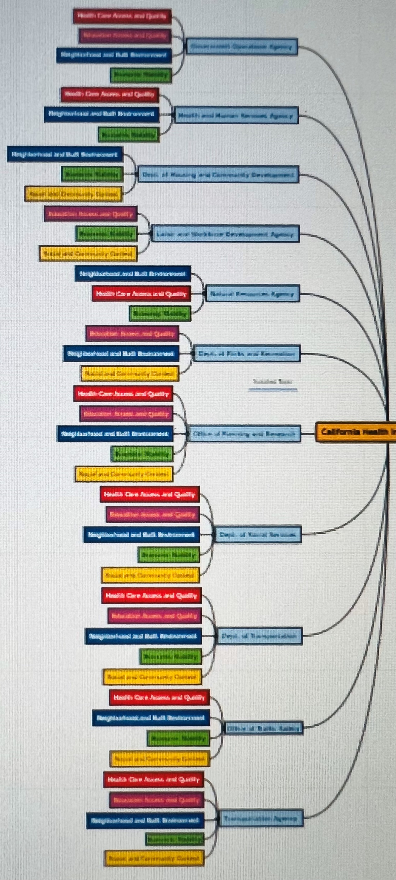
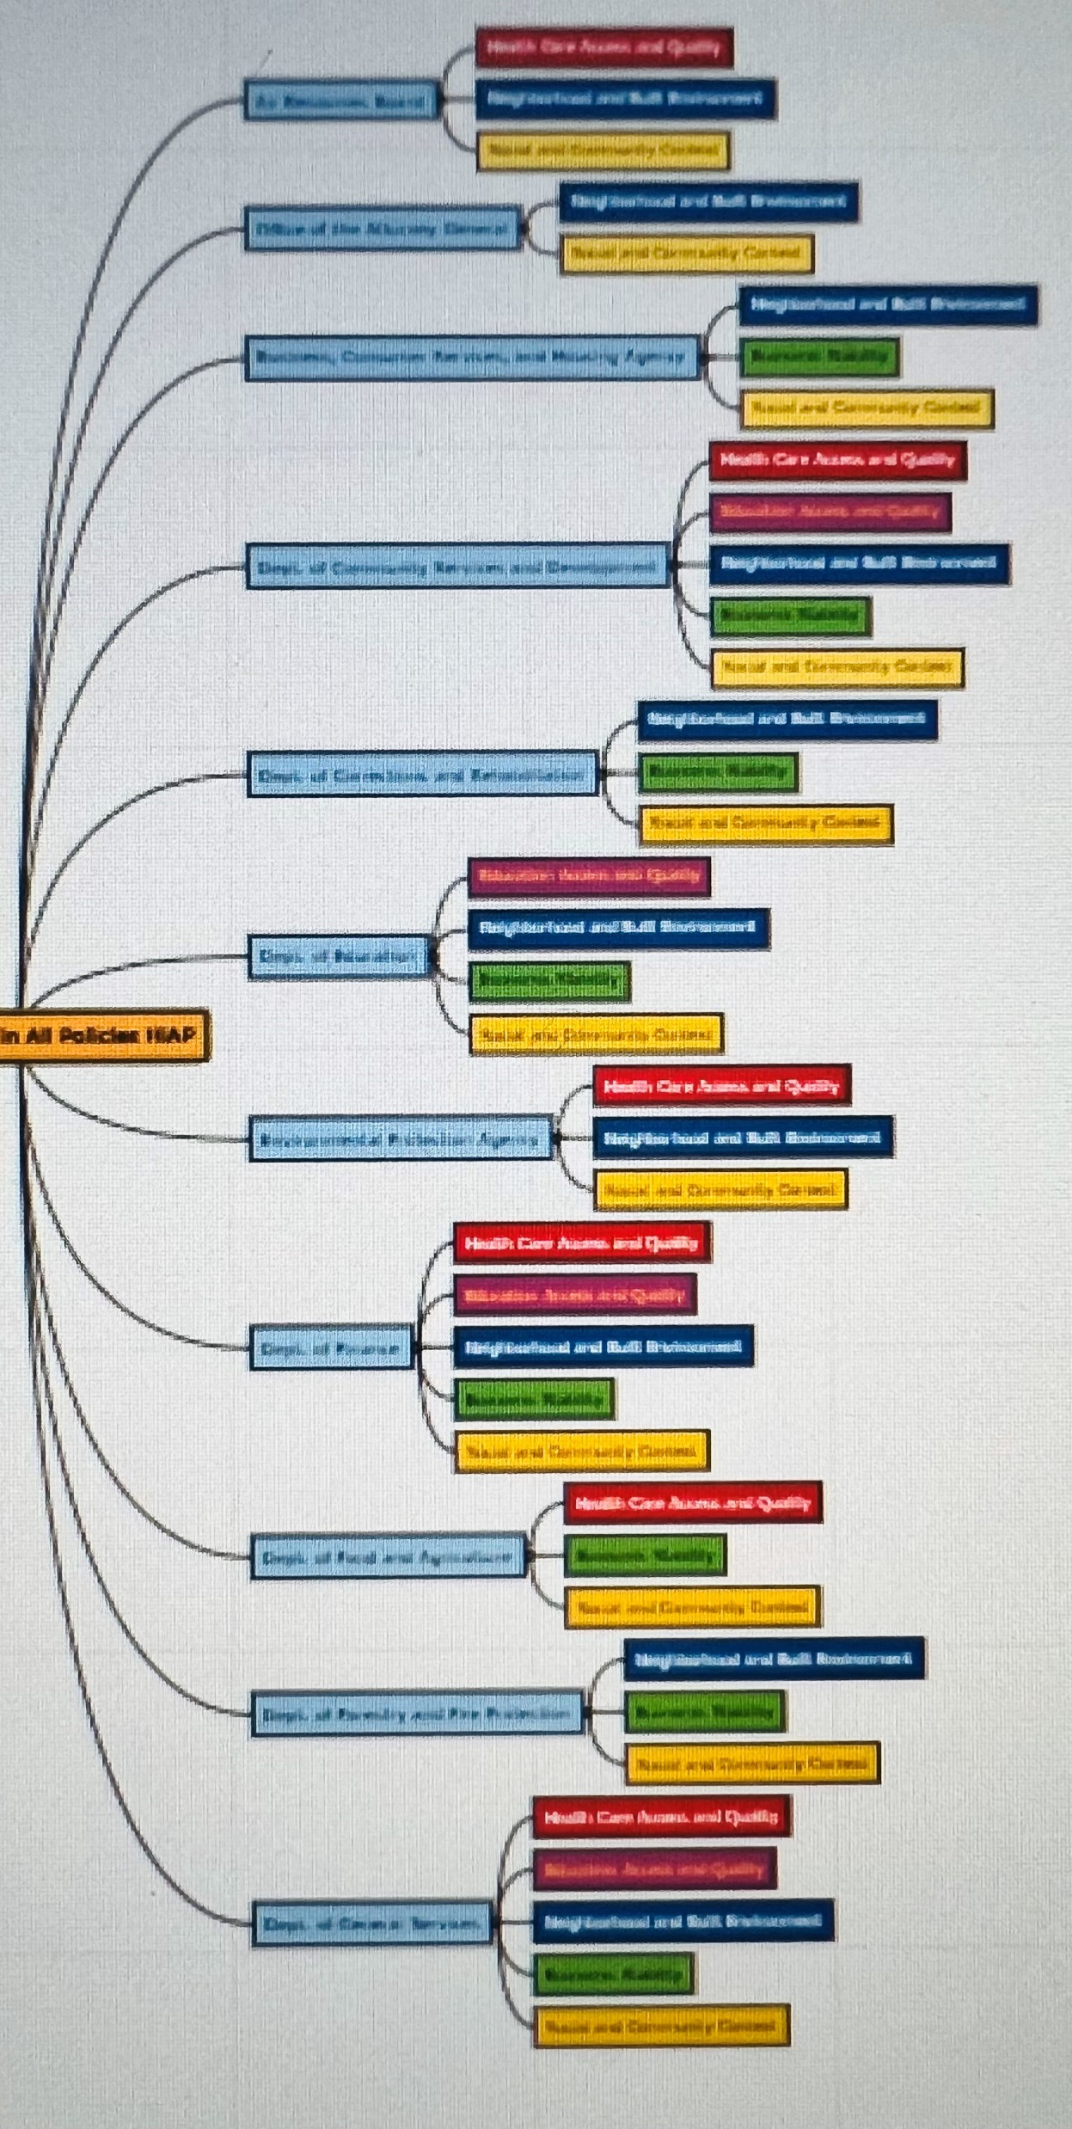
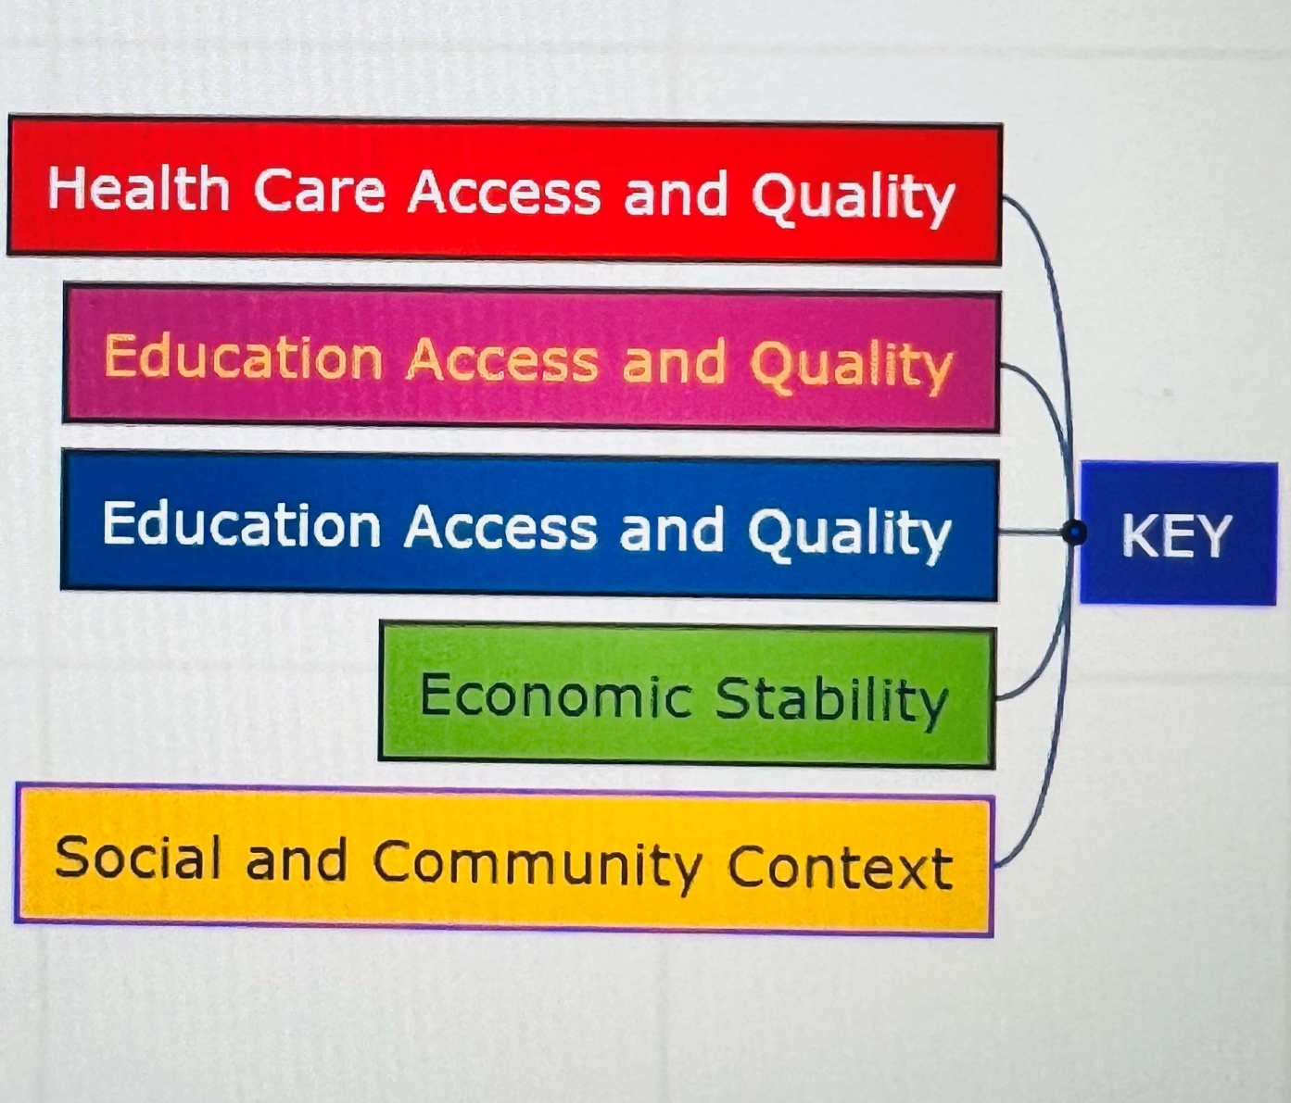
The Issues
Fiscal Challenges
Water Shortages
Aging population
Increasing health inequities
Climate Change
The Research – from other countries
Europe
Finland
Australia
WHO
Governors Cabinet Debate
Executive Order No. S-04-10
APENDIX I

